Slide 1

California Used Light-Duty Electric Vehicle Market 2019–2022
Consumer Demographics & Sales Trends
With thanks to CSE staff Regina McCormack, John Anderson
June 2025
Janet Bowers, Ben MacNeille, Nicholas Pallonetti

Slide 2
Question & Methodology
Overall Question | What was the state of the used EV market in California 2019–2022? To what extent is the used EV market expanding access to electric vehicles among a broader range of consumers?
Method | Examine trends in sales of new and used EVs Determine demographics of used EV buyers and preferred models
Data | Used EV Sales in CA 2019-2022 New EV Sales in CA 2019-2024 Alliance for Automotive Innovation Electric Vehicle Sales Dashboard CVRP rebate data, 2010–2023

Slide 3
Findings and Recommendations
Major findings | Healthy Supply: Used EV Pipeline is growing. New EVs are being purchased or leased at an increasingly high rate. Large Target Market: 38% of used ICEV buyers have household incomes less than $50,000, compared to 15% used EV buyers.
Recommendations | Recognize potential for increased supply of used EVs in future years, which will add inventory and choice for used EV buyers but may stress incentive programs. Maintain incentive programs for lower-income used EV buyers.

Slide 4
I. California Used Vehicle Market:
Overview and Insights from 2019–2022

Slide 5
New vs Used EV Market Share
New vs Used EV Market Share
Used Vehicle Market
New Vehicle Market
New EV Sales
New Non-EV Sales
  Used vehicle sales are 2x new vehicles sales
  New EV sales are 8x higher than used EV sales
  Used EV sales in CA grew from 1.9% of all sales in 2019 to 2.2% of all sales in 2022.
  This represents a 37% growth rate from 2019–2022.
  Contains data from S&P Global Mobility © 2022; vehicle records filtered by personal registration types only
  Used Data (2019–2022): N= 14,046,772; New Data (2019–2022): N= 759,505
  New Data (2023–2024): Alliance for Automotive Innovation Electric Vehicle Sales Dashboard
  Source for new EV totals (223–2024): https://ww2.arb.ca.gov/news/california-moves-accelerate-100-new-zero-emission-vehicle-sales-2035
5

Slide 6
New vs Used EV Market Share
Used Vehicle Market
New Vehicle Market
EV Sales
Non-EV Sales
  New EV sales in CA grew 117% from 2019–2022.
  Used vehicle sales are 2x higher than new vehicles sales.
  New EV sales are 8x higher than used EV sales
  Contains data from S&P Global Mobility © 2022; vehicle records filtered by personal registration types only
  Used Data (2019–2022): N= 14,046,772; New Data (2019–2022): N= 759,505
  New Data (2023–2024): Alliance for Automotive Innovation Electric Vehicle Sales Dashboard
  Source for new EV totals (223–2024): https://ww2.arb.ca.gov/news/california-moves-accelerate-100-new-zero-emission-vehicle-sales-2035

Slide 7
New vs Used EV Market Share
New vs Used EV Market Share
Used Vehicle Market
New Vehicle Market
EV Sales
Non-EV Sales
New EV Sales in 2023–2024 comprised ¼ of all new vehicle sales.
  Contains data from S&P Global Mobility © 2022; vehicle records filtered by personal registration types only
  Used Data (2019–2022): N= 14,046,772; New Data (2019–2022): N= 759,505
  New Data (2023–2024): Alliance for Automotive Innovation Electric Vehicle Sales Dashboard
  Source for new EV totals (223–2024): https://ww2.arb.ca.gov/news/california-moves-accelerate-100-new-zero-emission-vehicle-sales-2035
7

Slide 8
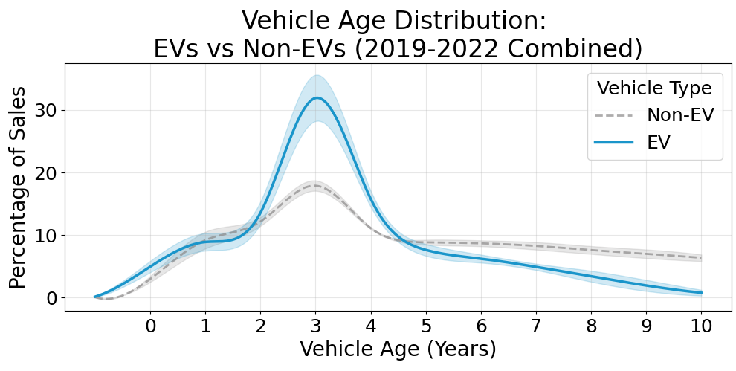
Distribution of Used Vehicle Sales by Vehicle Age and Year
Why is the largest proportion of used EVs three years old?
  Lease expirations (typically 3 years)
  Early-adopters seeking newer and better technologies^{1,2}
Used EV market is much less mature; fewer older EVs are available (or desired).
  Shaded bands represent ±1 standard error of the mean, capturing year-to-year variability. Curves were smoothed using cubic spline interpolation for visual clarity.
  Contains data from S&P Global Mobility © 2022; filtered by personal registration types only. Used Data (2019–2022): N= 14,046,772
¹C.R. Forsythe, K.T. Gillingham, J.J. Michalek, & K.S. Whitefoot, Technology advancement is driving electric vehicle adoption, Proc. Natl. Acad. Sci. U.S.A. 120 (23) e2219396120, https://doi.org/10.1073/pnas.2219396120 (2023).
²Diouf, B. (2025). Modeling the Used Vehicle Market Share in the Electric Vehicle Transition. World Electric Vehicle Journal, 16(1), 29.

Slide 9
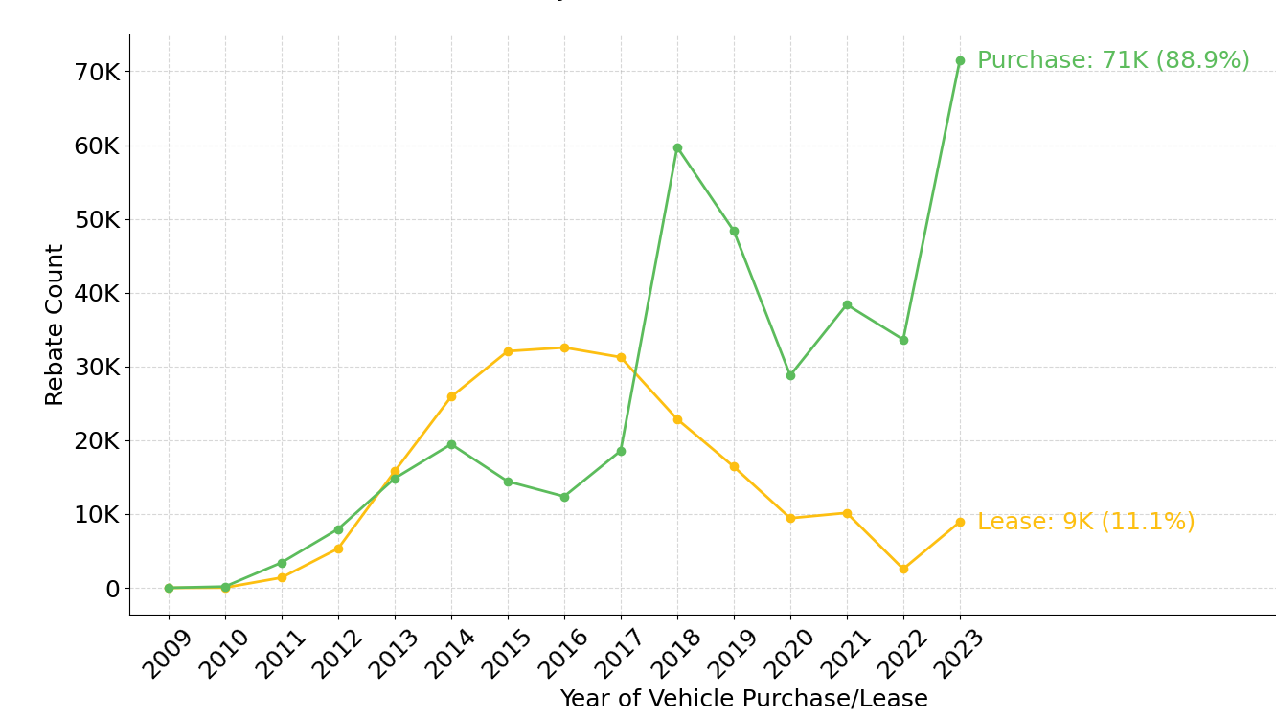
CVRP Lease Trends through 2023
CVRP-Rebated Vehicles
Lease rates dropped precipitously 2017–2018 because…
Tesla Model 3,which received the highest percentage of CVRP Rebates, was not eligible for lease by Tesla.
Tesla Model Y was lease-eligible in 2020, but came later in the timeline and did not allow end-of-lease buyout (making it less attractive).
Despite the low lease rates toward the end of the program, CVRP leasing will result in used EV availability in future years.
  Data reference:
  Center for Sustainable Energy (2024). California Air Resources Board Clean Vehicle Rebate Project, Rebate Statistics. Data updated: 6/5/2024. Retrieved 6/5/2024 from cleanvehiclerebate.org/rebate-statistics.

Slide 10
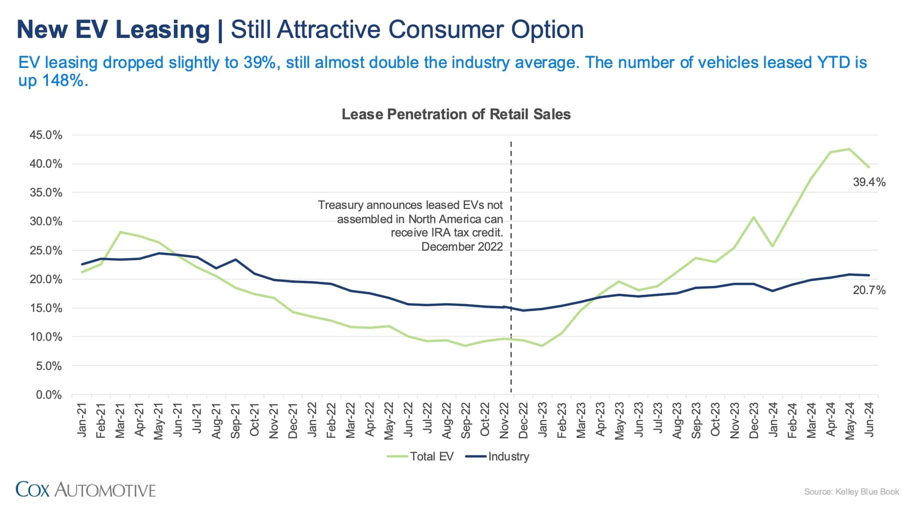
Lease Trends after 2023
Nationally, EV lease rate surpassed ICE lease rate in 2024 and are projected to continue in future.
After Nov 2022: Lessees could take advantage of the IRA tax credit even for vehicles that are not eligible for personal purchase tax credit.
Source for US graphic: Cox Automotive. Taken from:
"Tesla Sales Slump Won't Stop Record U.S. EV Sales In Q3." InsideEVs. October 2, 2024. https://insideevs.com/news/735231/ev-sales-q3-2024-tesla/.

Slide 11
Summary: The Increasing Supply of Used EVs
New EV sales are Increasing
Market share for new EVs is more than 25% in CA in 2024
CVRP has ended contributing ~600,000 new EVs on CA roads
Leases for new EVs are increasing
Lease rates surpassed ICE lease rates in 2024
People are taking advantage of “Leasing loophole” in FTC
Fleet sales are turning over
Fleets that bought EV models will be seeking to replace with other newer models
Rentals give customers a chance to test out EV driving
What is still needed?
Used incentive programs for lower income buyers (who comprise ~40% of all used vehicle buyers)
More infrastructure to facilitate charging and reasonable prices for electricity
Leases facilitate entry for many buyers and accelerate supply of used EVs at predictable rates
2/3 of private fleet operators use leased vehicles
1
2
4
3
4
4

Slide 12
II. Used Vehicle Consumer Demographics and Vehicle Choices

Slide 13
Used Vehicle Consumer Income (CY 2022)
The largest percentage of used ICE vehicles (38%) was purchased by those at lowest income level.
The largest percentage of used EVs (30%) was purchased by those at the highest income level.
  Contains data from S&P Global Mobility © 2022; Strategic Vision © 2022
  Data sources: Used Vehicle Market: N=3,163,982 (unavailable income data: 31%). New Vehicle Market: N=18,963 (unavailable income data: 17%).
  Notes: (1) Data filtered by personal registration types only; (2) EVs include BEVs, PHEVs, and FCEVs with MY ≥ 1981

Slide 14
Used Vehicle Consumer Age (CY 2022)
There was essentially no difference in buyer age between EV and Non-EV buyers
The largest percentage of used vehicles is between 35–44 years of age.
  Contains data from S&P Global Mobility © 2022
  Data source: Used Vehicle Market: N=3,1073,123 (unavailable age data: 30%).
  Notes: (1) Data filtered by personal registration types only; (2) EVs include BEVs, PHEVs, and FCEVs with MY ≥ 1981

Slide 15
Used EV Ranked Sales (2020–2022) by Income Group
Low Income
1. Chevrolet Volt
7. Ford C-Max
8. Toyota Mirai
All Buyers
1. Tesla Model 3
2. Tesla Model 3
3. Ford Fusion
4. Nissan Leaf
5. Toyota Prius Prime
6. Tesla Model S
9. Honda Clarity
10. Fiat 500
2. Chevrolet Volt
3. Tesla Model S
4. Nissan Leaf
5. Toyota Prius Prime
6. Ford Fusion
7. Tesla Model X
8. BMW 530
9. BMW i3
10. Tesla Model Y
The top 6 vehicle models are shared by lower income and all buyer consumer groups
All Buyers:
  Higher-priced BEVs occupy positions 7-10 of top 10 models
Low Income Buyers:
  Lower-priced non-BEVs occupy positions 7-10 of top 10 models
Contains data from S&P Global Mobility © 2022
Used Vehicle Data (N=10,316,877)

Slide 16
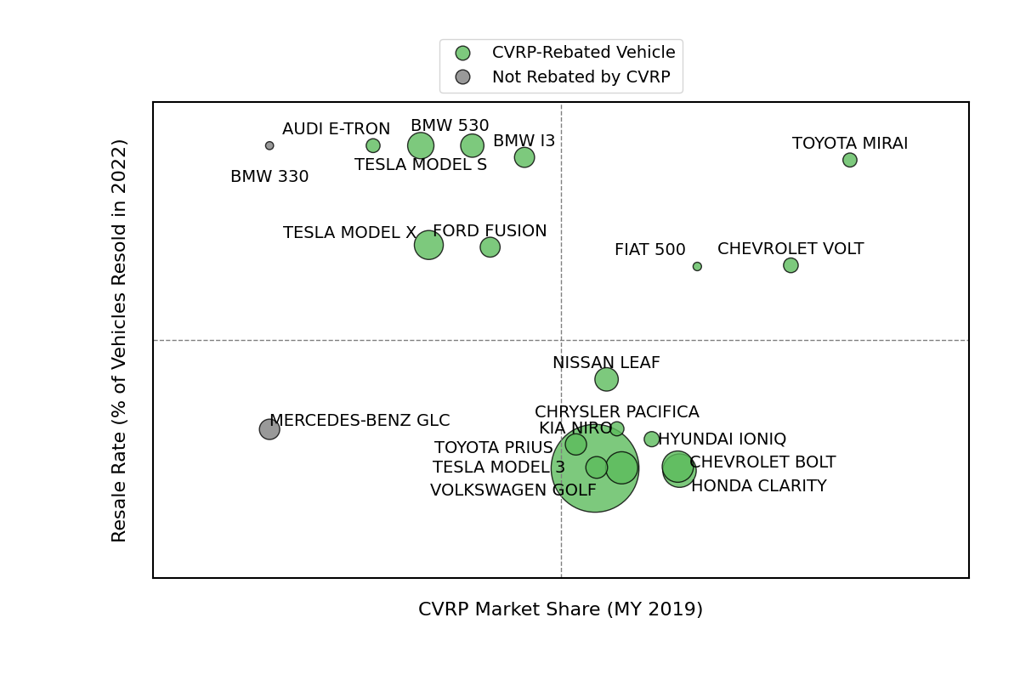
Top Used Models: Resale Value vs CVRP Eligibility
High
High rebate %, high resell (upper right):
  CVRP Rebated vehicles require lower incomes and MSRPs
  Vehicles retain resale value; attract lower income buyers
  Toyota Mirai, Fiat 500 and Chevrolet Volt
High rebate %, low resell (lower right):
  Vehicles turn over less frequently
  Lower-priced models attract lower income buyers
  Model 3, Bolt, Clarity, Niro
Low rebate %, high resell (upper left):
  Vehicles retain resale value; higher income buyers
  BMW, Tesla S, Tesla X, Audi
% of 2019 New EV Sales
that were Resold in 2022 by Model
Low
% of 2019 New EV Sales that were
Rebated by CVRP by Model
High
Contains data from S&P Global Mobility © 2022
Used Vehicle Data (N= 3,245,668), New Vehicle Data (N= 1,199,991)
Notes: EVs include BEVs, PHEVs, and FCEVs with MY ≥ 1981;Data filtered to personal registration types only. (2) The Toyota Mirai, a fuel cell vehicle, was not sold widely, but a large percentage of the sales were rebated and the Mirai had a very high turnover rate.

Slide 17
III. Conclusion
Takeaways and Next Steps

Slide 18
Summary of Findings and Projections:
Healthy Supply of New EVs increased to roughly 25% of all new light-duty vehicle sales in 2023 and 2024, indicating that the supply of used EVs will increase in coming years
  New EV sales are 8x higher than used EV sales
  Used ICE sales are 2x higher than new ICE vehicles 2:1
Used EV sales peak at 3 years of age: Over 30% of used EV sales are 3 years old—compared to a more even spread for Non-EVs
  Used EVs enter the market faster than ICE vehicles
  Increase in EV leases 2014–2017 and again 2023-2024
Large Target Market of Low-income Buyers: Low-income buyers comprise 38% of used Non-EV market
  PHEVs were more popular with lower income buyers, but BEVs took over by 2022
  Barriers to EV adoption exist; new programs focusing on used EV incentives will help
Income Level | Used EV | Used Non-EV
Less than $50,000 | 15% | 38%
More than $200,000 | 30% | 12%

Slide 19
Limitations, Next Steps, & Directions for Future Research
1. The used EV market grew 37% between 2019–2022. However, several world-wide events may have affected this report:
  The COVID pandemic caused major manufacturing delays which affected EV chip availability rates more than traditional ICE vehicle production.
  CA and federal incentive programs may be removed or re-designed in coming years.
  The EV market has shifted in recent years towards more leases, which may increase the pace at which new EVs are resold.
  Next step: follow-on analysis of more recent used car data for comparison.
2. Demographics may continue to be biased by missing data
  Limited demographic characteristics available (age & income ~10-30% missing, gender and price severely limited and auto-generated by S&P)
  Next step 1: Acquire individual-level used vehicle data from survey company such as Strategic Vision to decrease missingness and consider alternative approaches for handling missing data
  Next step 2: Review public data and reporting on used EV availability to enhance understanding of supply and demand in a changing landscape.
  * Algorithmically-estimated gender (not previously reported) provided by S&P Global Mobility suggests only minimal difference between new and used markets and between older and newer MY vehicles.

