Slide 1



Consumer Preferences of EV Drivers
A Comparison of Tesla Drivers and Other EV Drivers
November 2025
Julie Parker, Christian Sheja
with thanks to Amber Moore, Regina McCormack and Shira Orlowek

Slide 2

Objective
Examine factors related to BEV purchases and leases in the EV market in California and learn why Tesla is the dominant choice among EV adopters.

Slide 3
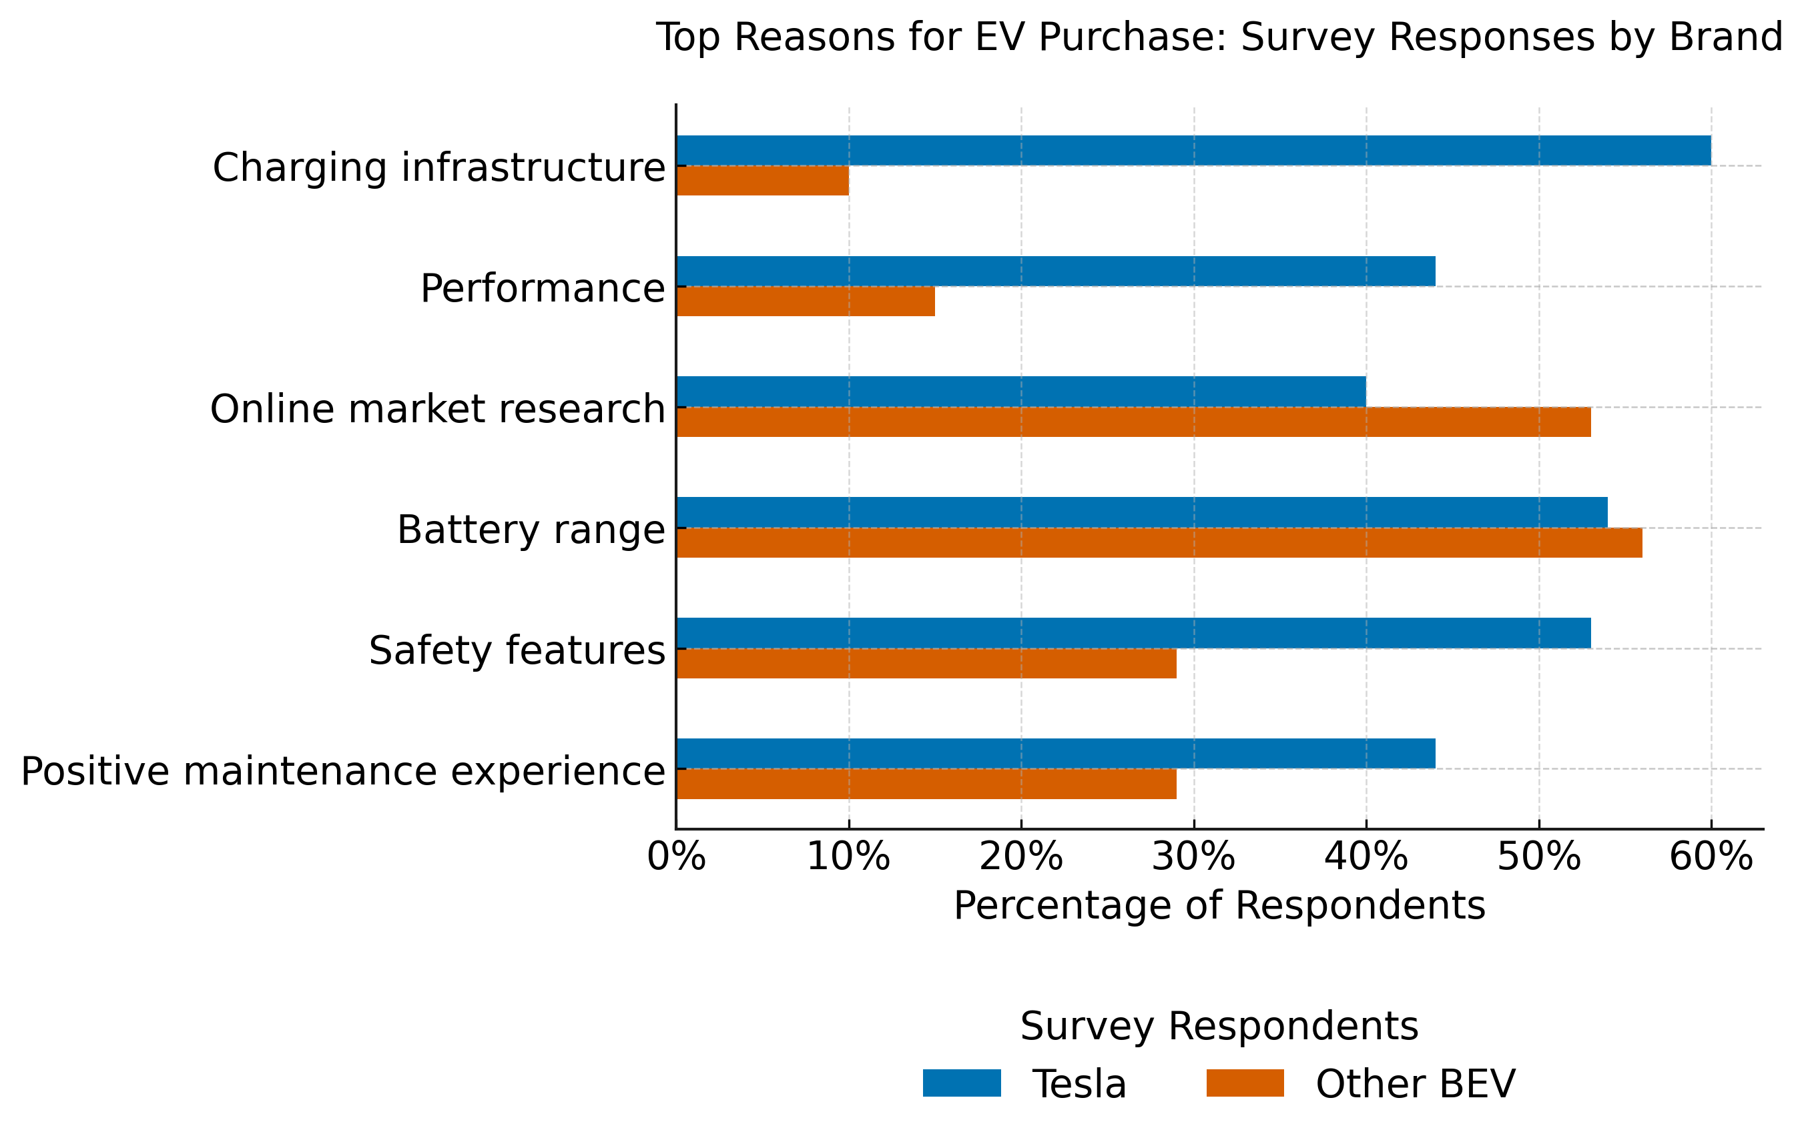
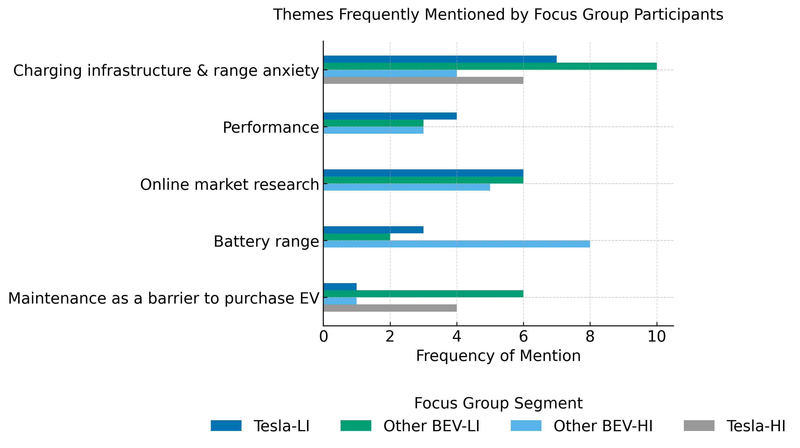
COMPARING SURVEY AND FOCUS GROUP INSIGHTS ON EV PURCHASE MOTIVATIONS
Battery range, charging infrastructure, performance and online market research emerged as common themes across both methods, reflecting shared priorities and decision-making influences among EV drivers.
Survey responses show brand-specific priorities — Tesla drivers emphasized charging infrastructure and performance, while Other BEV drivers prioritized battery range and safety features.
Focus group participants frequently discussed barriers (e.g., range anxiety, long charging wait times, maintenance concerns) in more nuanced and personal ways not captured in the survey format.
Focus groups – Total of 4 groups (low- and high-income CVRP recipients): 2 comprised Tesla purchasers or lessees, and 2 comprised other BEV purchasers or lessees, with each vehicle brand represented across both income levels.
Surveys – 408 survey responses to a 20-question survey, half of which were sent to Tesla purchasers or lessees, with the other half sent to purchasers or lessees of alternate BEV models. Survey respondents acquired their vehicle between July 2017 through 2023.

Slide 4





Key Takeaways
Survey​s
Focus Groups
Tesla drivers have high confidence in the Tesla EV safety reputation and brand reputation.
Recommendations from family/friends and personal research dominate influence, but high-income drivers of non-Tesla models also prioritize range.
Tesla drivers ranked their experiences related to range, maintenance and charging higher than other BEV drivers.
All drivers prioritize vehicle features and technology. Low-income buyers also prioritize price while high-income prioritize fast charging.
Tesla drivers ranked performance as having greater influence on their decision to purchase or lease their EVs than other BEV drivers did for their EVs.
Concerns about charging infrastructure and range anxiety affect all drivers. High-income drivers mitigate by installing home chargers.

Slide 5
Methodology
Survey
Results
Developed 20-question survey, issued in December 2023 and January 2024. Half of the surveys of CVRP recipients were sent to Tesla purchasers or lessees and the other half were sent to purchasers or lessees of alternate BEV models.
Survey examined 408 survey respondents who acquired their vehicle between July 2017 through 2023.¹
Determined key takeaways that summarize why Tesla is a dominant choice over other BEV models.
Focus Groups
Survey
Analysis
Results
Focus Groups
Analysis
Conducted 4 focus groups, 2 of which included CVRP recipients who are Tesla purchasers or lessees and 2 of which included CVRP recipients who are purchasers or lessees of alternate BEV models.
Reviewed responses from focus groups and survey participants to determine common themes.
1. This is a time when the Tesla Model Y was available. We chose a period with this availability to capture responses among CVRP participants that could make a comparable choice between a Tesla model and other EV models. Note this excludes March 16, 2022, through January 11, 2023, when the Model Y was briefly unavailable.
Duis aute irure dolor in reprehenderit in voluptate velit esse cillum dolore eu fugiat nulla pariatur. Excepteur sint occaecat cupidatat non proident, sunt in culpa qui officia deserunt mollit anim id est laborum.
1. This time period marks when the Tesla Model Y was available. We chose a time period with this availability to capture responses among CVRP participants that could make a comparable choice between a Tesla model and other EV models. Note this time period excludes March 16, 2022 through January 11, 2023, when the Model Y was briefly unavailable.

Slide 6

Survey
Results
Prevailing Responses by Tesla and Other BEV Drivers

Slide 7
Key Factors That Influenced the Purchase or Lease of a CVRP-rebated Vehicle
Surveyed CVRP Participants

Slide 8
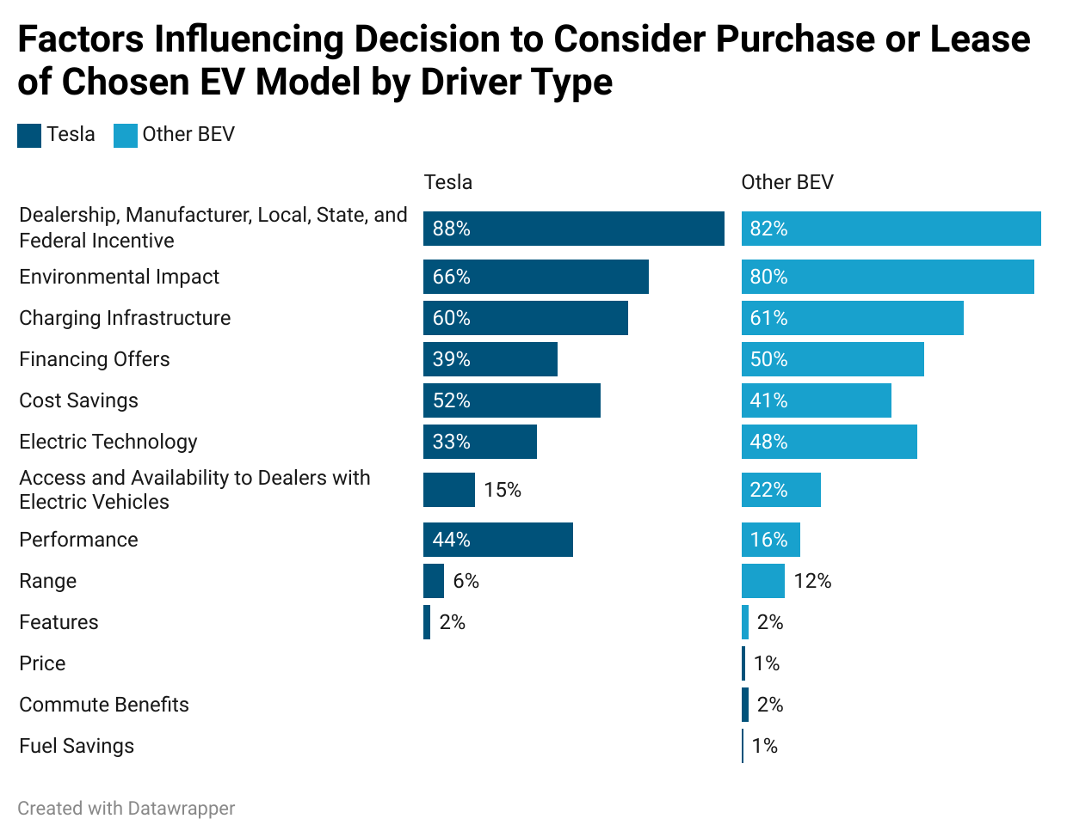
When considering an EV,
various factors influenced driver's purchase or lease decisions
What was common among drivers?
Top purchase decision influences among all drivers, regardless of model, were incentives, environmental impact and charging infrastructure.
What was different among drivers?
Financing offers and electric technology were less influential to Tesla drivers than drivers of other BEVs.
Performance had a greater influence on the purchase or lease decision for Tesla drivers than for drivers of other BEVs.

Slide 9
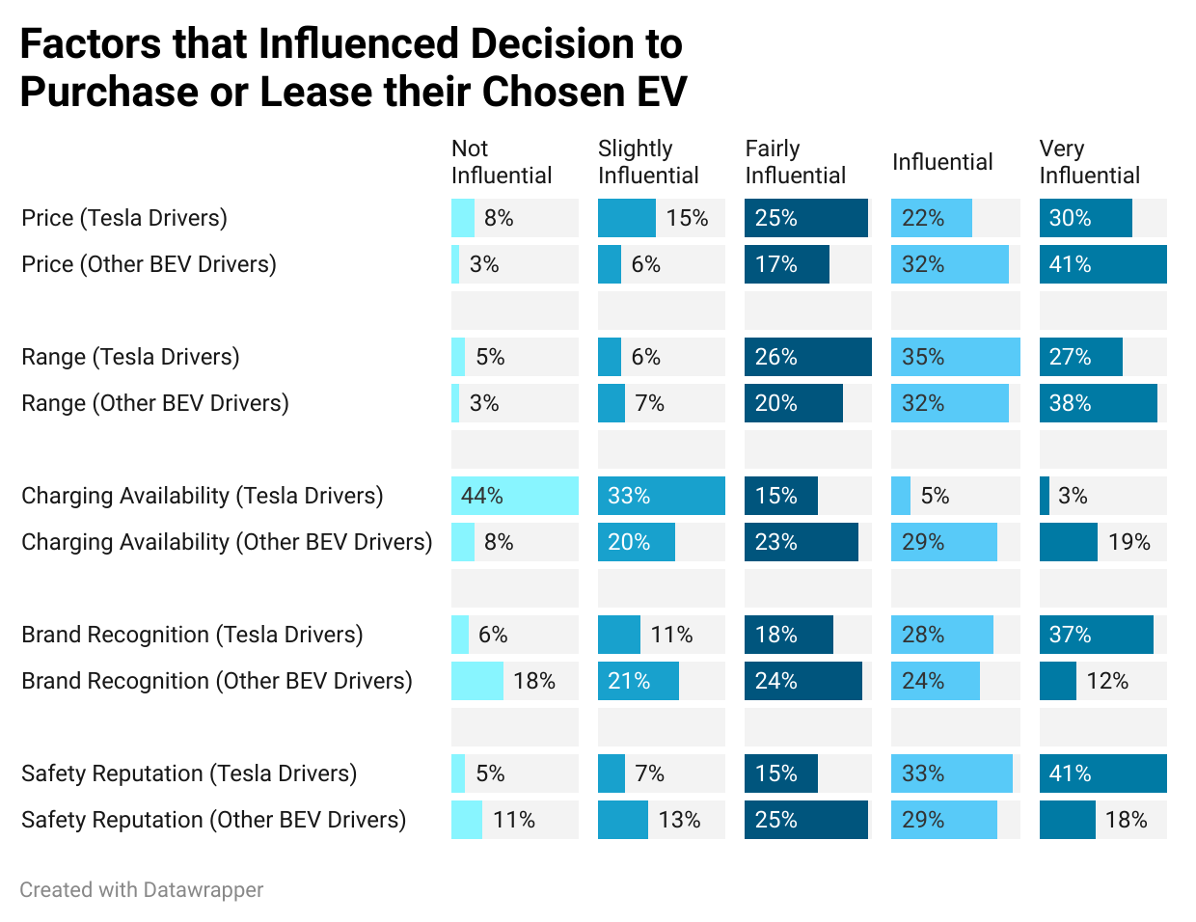
Vehicle specific factors also had varying degrees of influence on driver's purchase or lease decisions
What was common among drivers?
There were no major similarities between Tesla drivers and drivers of other BEVs for these factors of influence.
What was different among drivers?
Charge availability, price and range had much more influence for drivers of other BEVs than for Tesla drivers in their decision to purchase their chosen EV.
Safety reputation and brand recognition had a higher influence for Tesla drivers in their decision to purchase their chosen EV.
Table reflects percentage of influence (sums left to right) among participating Tesla and Other BEV drivers for each of 5 factors.

Slide 10
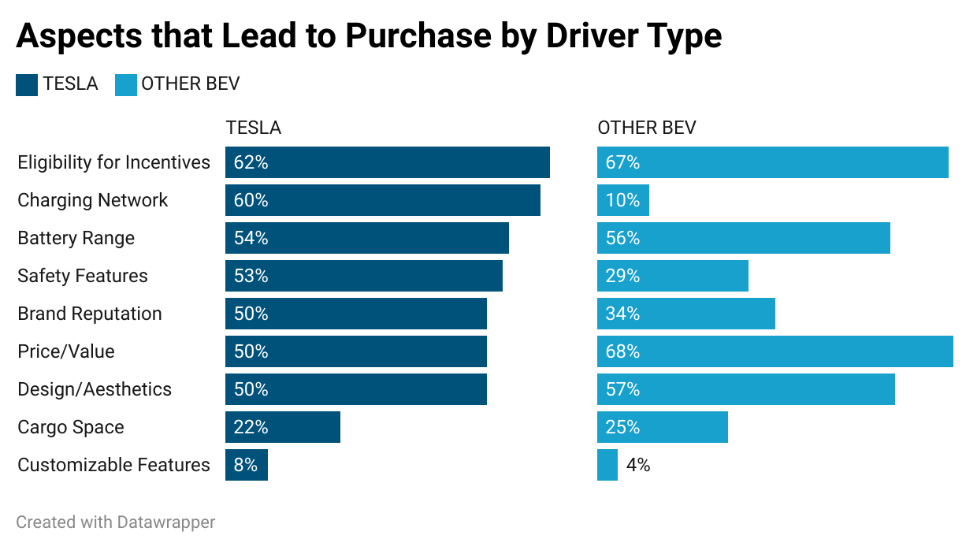
Tesla drivers and other BEV drivers ranked additional vehicle-specific factors that influenced their purchase or lease decision
What was common among drivers?
Top reasons among all drivers, regardless of model, were incentive eligibility, battery range, and design/aesthetics.
What was different among drivers?
Price/value appear to influence drivers of other BEVs more than Tesla drivers.
Tesla drivers were influenced more than drivers of other BEVs by charging network, safety features and brand reputation.

Slide 11
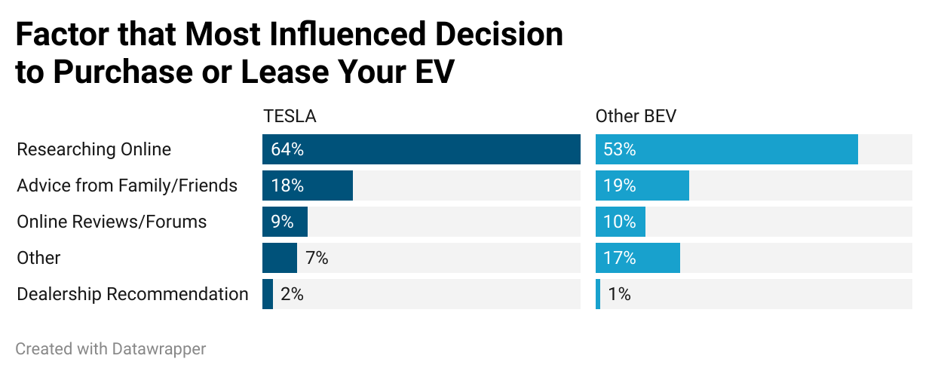
Other factors related to the ways a driver learns about EVs had influence on purchase or lease decisions
What was common among drivers?
Online research and advice from friends were most influential for both Tesla drivers and drivers of other BEVs.
What was different among drivers?
There was minimal difference between Tesla drivers and drivers of other BEV's in how these factors influenced their decisions to purchase or lease their respective EVs.

Slide 12
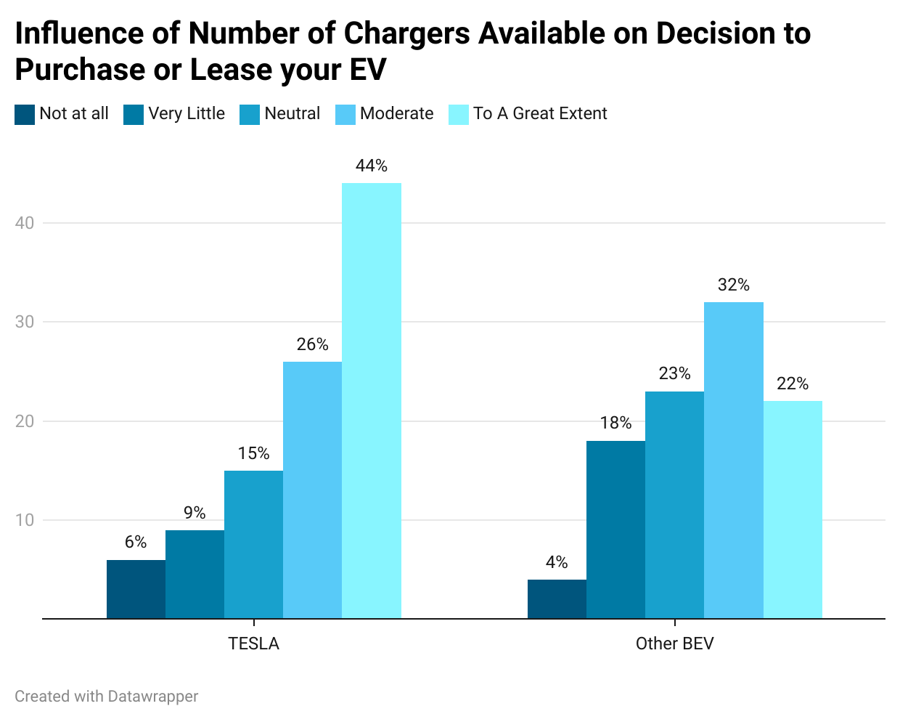
In addition, charger availability impacted driver's model choice when considering purchase or lease of their EV
What was common among drivers?
Both Tesla drivers and other BEV drivers indicated that the number of chargers available did have some level of influence on their decision to purchase or lease their EV.
What was different among drivers?
The number of chargers available had a greater influence on Tesla drivers in their decision to purchase or lease their EV than on other BEV drivers. Nearly half of Tesla drivers indicated they were influenced to a great extent.

Slide 13
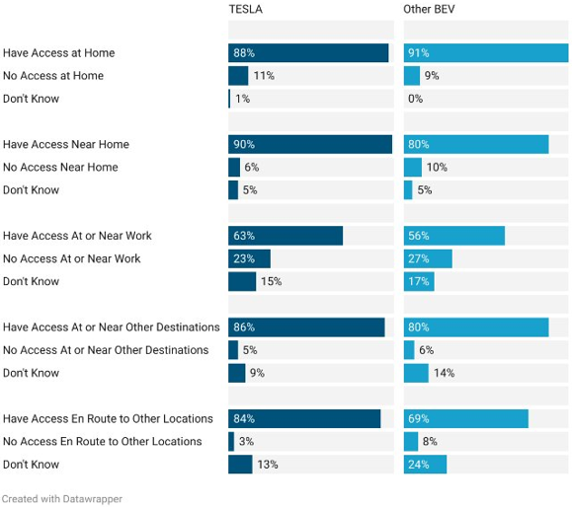
When asked about access to charging, Tesla drivers and other BEV drivers indicated varied levels of access
Access to EV Charging Source by Driver Type
What was common among drivers?
Both groups have a high number of drivers who have access to home charging.
What was different among drivers?
A greater number of Tesla drivers indicated that they have access near their home and enroute to other locations over other BEV drivers.
Table reflects percentage (sums down by each level of charging access) among participating Tesla and Other BEV drivers.

Slide 14
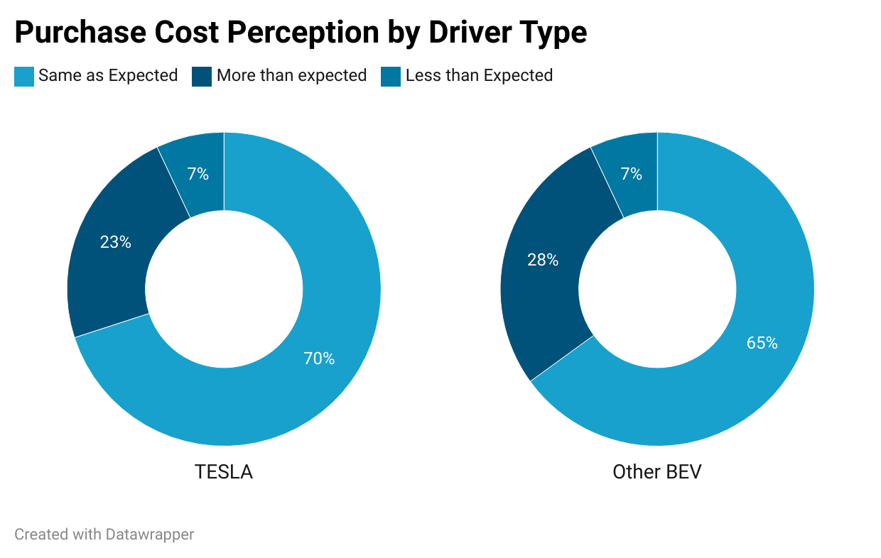
When asked about their cost to purchase, Tesla drivers and other BEV drivers had mixed perceptions
What was common among drivers?
Both groups ranked very low their perception that the cost to purchase their EV was less than expected.
What was different among drivers?
Tesla drivers indicated at a higher percentage than other BEV drivers that the cost to purchase was the same as expected.
Other BEV drivers indicated at a higher percentage than Tesla drivers that the cost to purchase was more than expected.

Slide 15
Ownership Experience Following Purchase or Lease of a CVRP-rebated Vehicle
Surveyed CVRP Participants

Slide 16
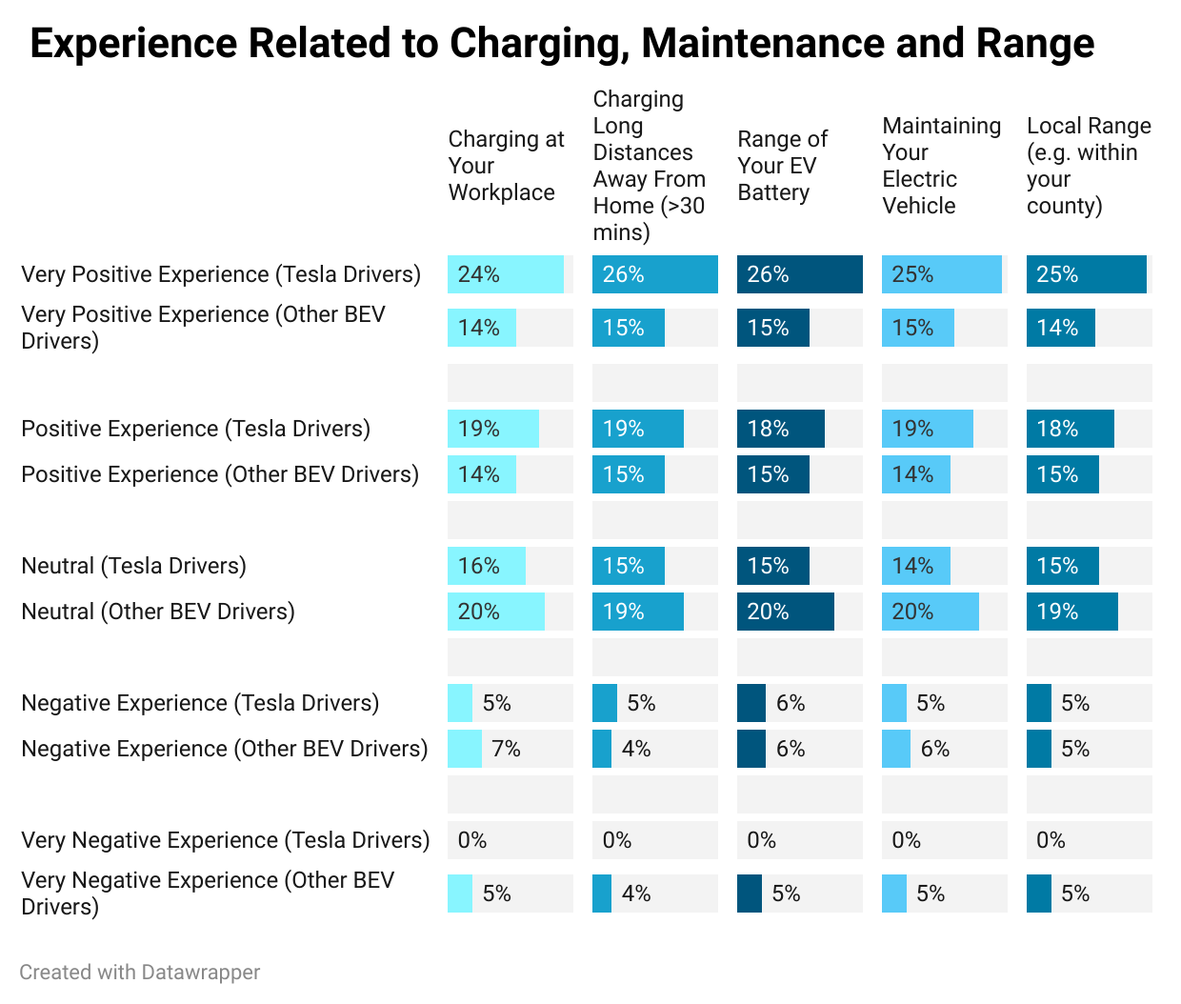
Tesla drivers and other BEV drivers indicated different levels of driver satisfaction experiences related to several vehicle-specific ownership factors as an EV owner
Negative or very negative experiences were very minimal for all drivers.
Among responses indicating negative experiences, both Tesla and other BEV drivers ranked their experiences about the same.
Tesla drivers ranked their experiences in all categories higher than other BEV drivers ranked theirs for both very positive and positive experiences.
Table reflects level of satisfaction (standalone percentage of total surveyed) for each of 5 factors among participating Tesla and Other BEV drivers.

Slide 17
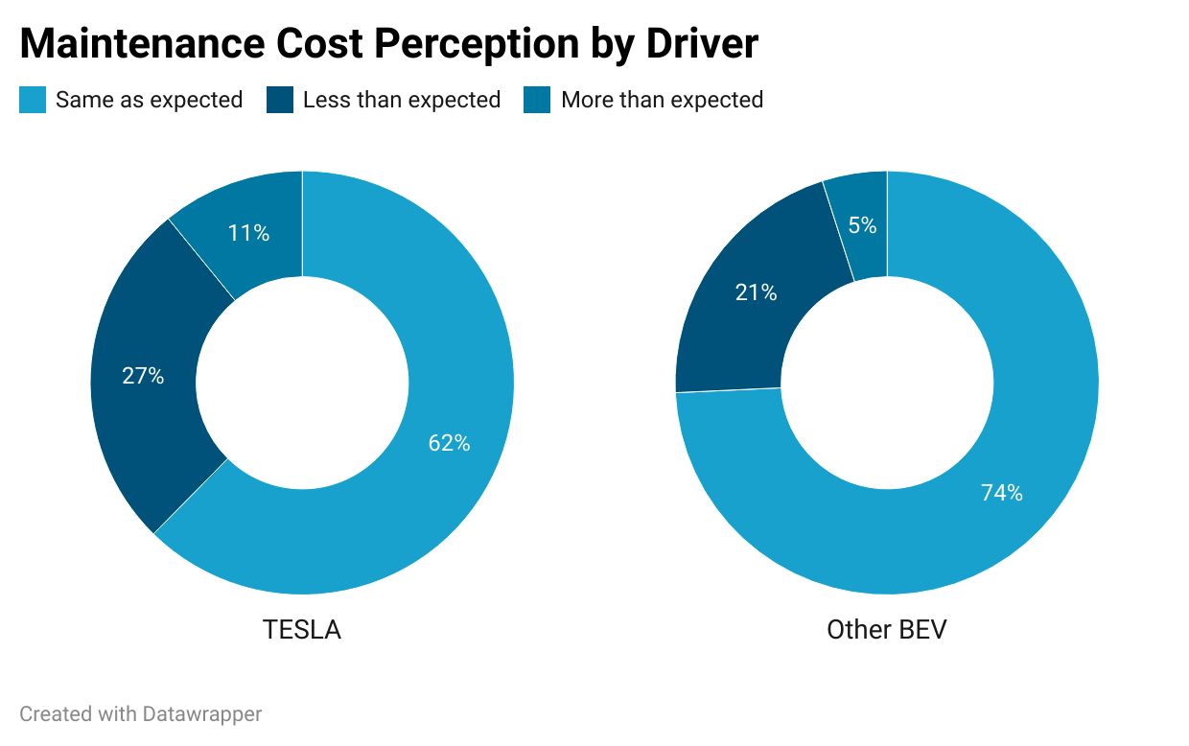
When asked about their EV maintenance cost, Tesla drivers and other BEV driver perceptions were diverse
What was common among drivers?
Both groups ranked very low the perception that the maintenance cost of their EV was less than expected.
What was different among drivers?
Other BEV drivers indicated at a higher percentage than Tesla drivers that the cost to maintain their EV was the same as expected.
Tesla driver indicated at a higher percentage than other BEV drivers that the cost to maintain their EV was more than expected.
Click for maintenance experience details from focus groups.

Slide 18
Maintenance realities of Tesla and Other BEV drivers
(Comments from Focus Group)
“I like the convenience of Tesla’s service because they sometimes offer the option of coming to your house to work on things instead of you having to go to a service center.” – Tesla driver
“It’s cheaper in terms of maintenance, so I really appreciate that. Usually, I would keep track of every 5,000 to 7,000 miles to get an oil change or something, but now I don’t even think about it or look at my odometer.” – Tesla driver
“Maintenance is way less than with any other car—you don’t have to worry about oil changes or someone stealing your catalytic converter or anything like that.” – Tesla driver
“It’s been almost no maintenance at all, except for the tires and windshield wipers.” – Tesla driver
“I haven’t had any issues with the car at all.” – Other BEV driver

Slide 19

Focus Group Results
Prominent Themes with Frequency of Mentions Accompanied by Relevant Quotes

Slide 20
Reasons for Purchasing or Leasing a CVRP-Rebated Vehicle
Low-income and High-income CVRP Participants

Slide 21
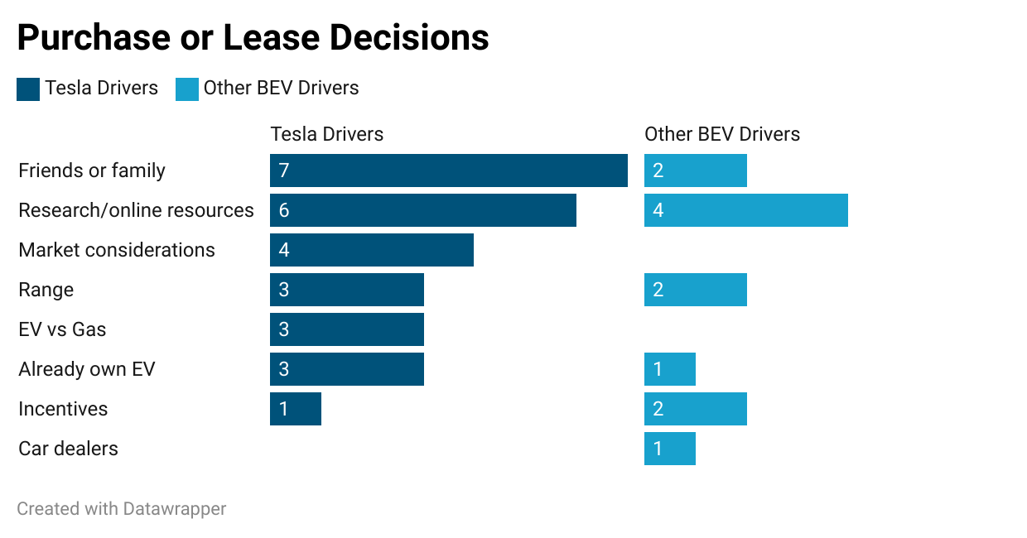
Low-income decision reasoning: Friends, family and online research
Friends and family recommendations for Tesla drivers
“I had a friend who owned a Tesla, and he is one of those savvy friends who researches everything."
“My brother had a Tesla."
Research/online resources for other BEV drivers
“I googled top 10 electric vehicles of the year kind of thing."
“I first saw it on the freeway and thought it looked cool. So, I googled a bunch of stuff – I was interested in going the EV route."
Other notable reasons: (see Frequency Chart for details)

Slide 22
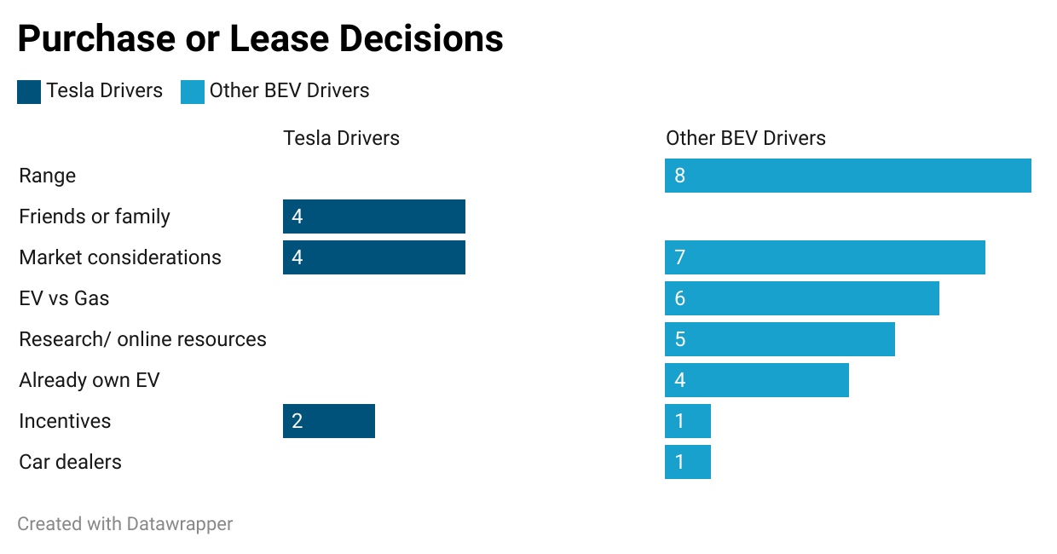
High-income decision reasoning: Friends or family recommendations, market considerations and range
Friends or family & market considerations for Tesla drivers
“My brother had a Tesla, and he is a big salesperson and so he had me drive his car and he showed me how to use it."
“I feel like Tesla is a bigger player in the EV industry and they were known for like more long range."
Range for other BEV drivers
“We have the Kona EV; it has great range like 265 miles. My husband drives it every day and he drives 80 miles a day and it’s working out great. We would have spent so much money on gas if we didn’t have the EV."
Other notable reasons (see Frequency Chart for details)

Slide 23
Key Factors Influencing EV Model Selection
Low-income and High-income CVRP Participants

Slide 24
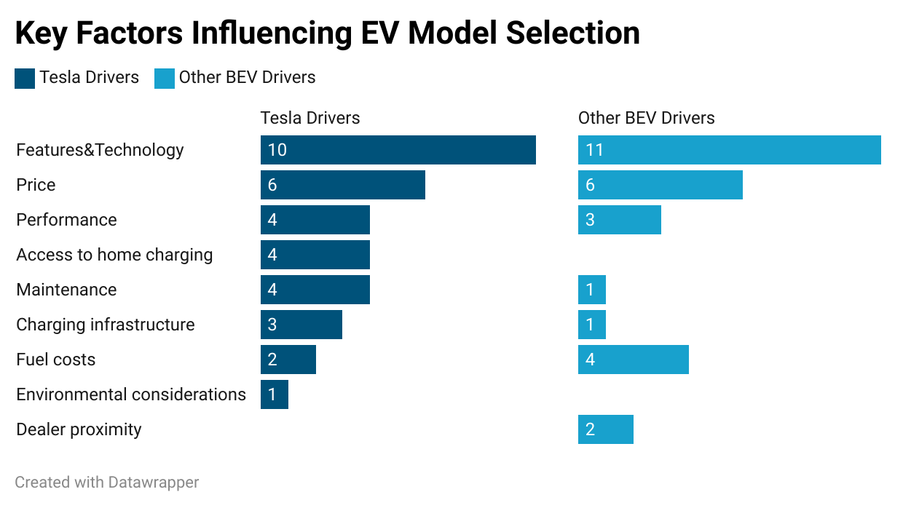
Features and price drive EV model selection for low-income participants
Features & technology and price for Tesla drivers and other BEV drivers
“I like how simple it is inside the car; you can find everything on the screen and not have to look for different things while you are driving."
“It turned out that I could afford the Model 3, so I decided to go with it."
“I wanted something with a lot more cargo space, so I chose something a little bit more like sporty and roomier."
“There were not a lot of options besides Tesla and Nissan, but they were out of my price range, so I decided to go with the Chevy."
Other notable factors (See Frequency Chart for details)

Slide 25
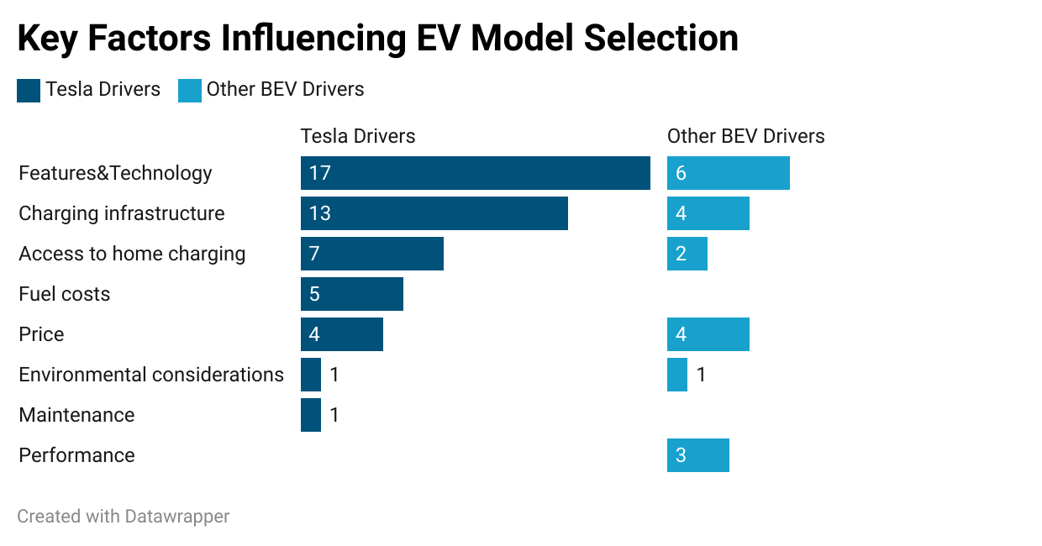
Technology and charging access drive EV model selection for high-income participants
Features & technology for Tesla drivers and other BEV drivers
“I love everything about the Tesla that I have except for certain quality and reliability issues."
“I bought my vehicle because I like the way it looks and has other perks such as fast charging. We can go from 20% to 80% in about 15 minutes if it is a good charger."
Charging infrastructure for Tesla drivers
“I have gone to like Texas and Arizona and you just like literally super charge all the way and its super quick."
Other notable factors (see Frequency Chart for details)

Slide 26
Other EV models considered by participants
They shared a range of models they considered: Tesla drivers considered high-end trims; and availability and style factors influenced other BEV drivers.
Tesla Drivers
Low income
“I didn’t look at anything other than the Model Y because of more cargo space; the Model S or X were a little bit out of my price range.”
High income
“We looked at the Toyota Rav4 Hybrid which was $48,000 during the pandemic, and we thought we would get a Tesla instead."
“We looked at Honda Clarity which is a hybrid. So, we were looking at hybrids for a while because we wanted to have that gas option."
Other BEV Drivers
Low income
“I like the Ioniq 5 but that it a little too bulky; the Kia EV6 kind of looked weird. We ultimately chose a Mach-E as it is almost like as gas car. It has different modes where you could do a quiet version, and you don’t hear anything or another mode where it would sound like an Engine."
“We looked at the Mazda EV which was a little bit sportier but what ended up sealing the deal for us was vehicle availability. Our local dealership didn’t have the Mazda.“
High income
No other EV model was reported.

Slide 27
Barriers to Driving EVs
Low-income and High-income CVRP Participants

Slide 28
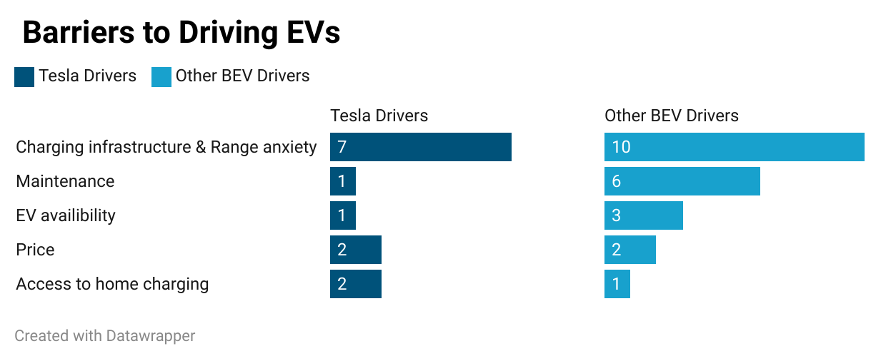
Range anxiety and charging wait times are key barriers for low-income participants driving EVs
Charging infrastructure and range anxiety
“The Tesla is a more city-friendly vehicle, my biggest worry would be to be that guy or girl that gets taken to the charging stations on a tow truck because I ran out of battery if I happen to take a long-distance trip.”
  - Tesla driver
“I feel like the ratio of EV owners and charging stations does not make sense. Some charging stations only have two or three plugins, and they always have huge long lines. I took a trip once which was supposed to be 4.5 hours, and it ended up being 7 hours and I had a seven-month-old with me. I have been a little scarred from that experience and haven’t been very far with my car since then.”
- Other BEV driver
Other notable barriers (see Frequency Chart for details)

Slide 29
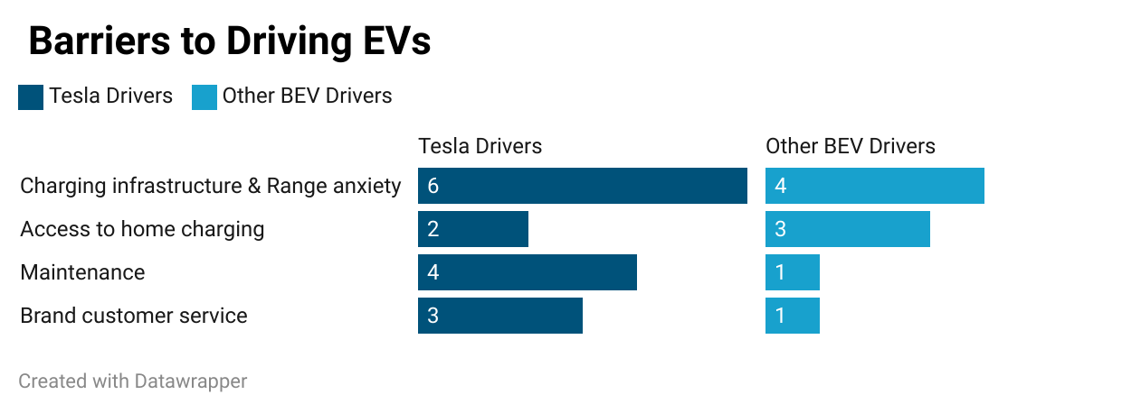
Charging infrastructure and range anxiety create barriers for high-income participants driving EVs
Charging infrastructure and range anxiety
“If you have to use non-Tesla chargers, it is a lot of hoops you have to jump through in order to charge. You have to have an external app like charge point and you have to have it already set up.”
- Tesla driver
“Public charging is a nightmare – sometimes they work, and sometimes they don’t. We installed a charger in our garage, and charging has become simpler for us.”
- Other BEV driver
Other notable barriers (see Frequency Chart for details)

Slide 30
EV Ownership Experience
Low-income and High-income CVRP Participants

Slide 31
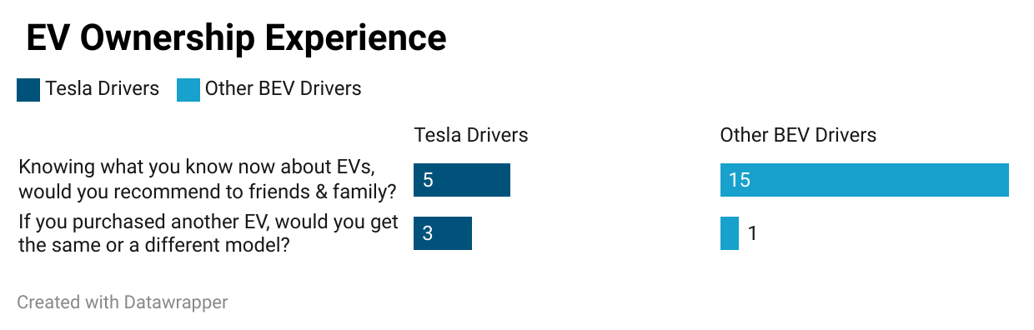
Low-income EV owners recommend EVs for short commutes, but not all models
“We did talk to our family and friends and not just about Tesla but EVs in general.”
“If you are like in the San Francisco area, I would recommend an EV, but I wouldn’t recommend the Tesla model 3 because I feel like there are a lot more other cheaper choices out there now.”
“If you commute less than 16 to 20 miles per day, I’d recommend an EV; if you take trips I’d recommend a hybrid.”

Slide 32
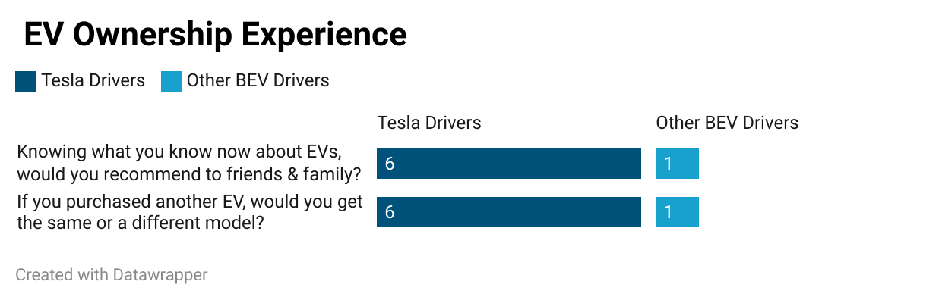
High-income EV owners recommend EVs based on charging access and lifestyle
“If they live in an apartment and didn’t have a dedicated place for charging, I advise against EVs.”
“For a household with two vehicles, I would advise my family and friends not to go electric with both of them – I would suggest getting one hybrid or gas and one electric.”
“Given that the market has become a lot cheaper now, I would upgrade to a bigger, better Model like the Y or X.”

Slide 33
Other findings from focus group analysis
“I would say that if you are concerned with like sustainability and all that then maybe do not consider an EV. The batteries need cobalt which many manufacturers get from the DRC and are exploiting millions of people, so that is supporting human rights violations."
“EVs are certainly not for everyone for example my wife would certainly not drive my car because it is too high tech for her, she is certainly a technophobe – that’s another factor to consider while buying an EV. Her Acura is a 2006 and she would not let me sell it and get something newer."

