Slide 1
Electric Vehicle Affordability and Incentive Amounts: 2025 Update
CARB Light-Duty Vehicle Purchase Incentives and Long-Term Plan Workgroup
July 10, 2025
Christian Sheja and John Anderson, Center for Sustainable Energy
Presented by: John Anderson, Center for Sustainable Energy
With thanks to Benjamin MacNeille, Cecilia De La Fuente, Mina Afayee, and others at CSE

Slide 2
Affordability calculation purposes
Does a given incentive mix enable meaningful affordable vehicle choice for consumers?

Slide 3
Outline
Cost Calculations
Affordability calculations overview
Results
Cost assumptions, inputs, and sensitivities

Slide 4
Electric vehicle costs in May 2025
Average cost of new EVs: $57,734*
Average cost of used EVs: $36,053*
Vehicle Costs
*(June 25, 2025). “How Much Are Electric Cars?” Kelley Blue Book.
https://www.kbb.com/car-advice/how-much-electric-car-cost/?msockid=362647cd9ef965712ee154a09fab64e1

Slide 5
Market context important to affordability conversation
New vehicle prices stable since summer 2025*
Used vehicle prices have risen slightly†
EVs generally remain more expensive than conventional vehicles
Average new vehicle: $48,799* (vs. $57,734)
Average used vehicle listing price: $25,470 ‡ (vs. $36,053)
New EV incentive programs aimed at lower-income consumers must overcome EV cost premium AND higher new vehicle costs to make vehicles affordable
* https://www.coxautoinc.com/market-insights/may-2025-atp-report/
† https://www.coxautoinc.com/market-insights/mid-june-2025-muvvi/
‡ https://www.coxautoinc.com/market-insights/used-vehicle-inventory-may-2025/

Slide 6
What do we mean by “affordable”?

Slide 7
Affordability calculations
15% of
monthly income
(
)
TOTAL
MONTHLY
OPERATING
COSTS
<
household purchase power adjustment
10% down payment
5-year (60-month) loan

Slide 8
Cost calculations
Loan Costs
Operating Costs
TOTAL
MONTHLY OPERATING
COSTS
+
=
Principal (incl. tax & fees)
Interest
Insurance
Fuel
Avg. other maintenance

Slide 9
Maximum monthly cost
Including interest, insurance, fuel, and lifetime-average maintenance costs
Four-person household
Income Level | Income | Max Monthly Cost
225% of FPL | $72,337 | $452
300% of FPL | $96,450 | $603
400% of FPL | $128,600 | $804
600% of FPL | $192,900 | $1,206

Slide 10
Vehicle inputs
New
2025 model year vehicles from FuelEconomy.gov
Make, model, and trim combinations where trim is related to electric range
Where price information is available
Used
2022 and earlier model year vehicles
Where vehicle is present in the fueleconomy.gov database
Model year, make, model, and trim combinations where trim is related to electric range
Where price information is available

Slide 11
Vehicle cost assumptions
Vehicle cost: MSRP or KBB Fair Purchase Price without options
Interest rates: new – 11.18% and used – 11.43%
Insurance premium: $337/month
Maintenance: $74/month (lifetime average)
Fees: $684
Sales tax rate: 7.25% (base CA sales/use tax)
Fuel costs: varies by vehicle, based on FuelEconomy.gov (electricity and gas)
Purchasing power adjustment for larger households

Slide 12
Not accounted for
Cost of installing vehicle charging infrastructure at home, if applicable
Financial flexibility to make a cash down payment or sufficient trade value from other vehicles
Access to credit assumed regardless of credit score

Slide 13
Affordable New Vehicles

Slide 14
Cash incentives and 8% interest cap reduces cost, but does not enable affordable choices
Four-person household
$96,450 income (300% FPL)
$9,500 PHEV and $10,000 BEV CC4A incentive applied to down payment
8% interest rate cap applied through Finance Assistance
New 2025 Model Year Options = 0
 | Vehicle Technology
Vehicle Size | BEV | PHEV
Small | 0 | 0
Large | 0 | 0

Slide 15
Affordable Used Vehicles

Slide 16
There are eight affordable used EV options without incentives
Four-person household
$96,450 income (300% FPL)
Used EV Options = 8 (5 models)
 | Vehicle Technology
Vehicle Size | BEV | PHEV
Small | 8 | 0
Large | 0 | 0

Slide 17
Addition of CC4A incentive adds 65 options
Four-person household
$96,450 income (300% FPL)
$9,500 PHEV and $10,000 BEV CC4A incentive applied to down payment
Used EV Options = 73 (21 models)
 | Vehicle Technology
Vehicle Size | BEV | PHEV
Small | 53 | 17
Large | 3 | 0

Slide 18
Interest rate cap adds four options
Four-person household
$96,450 income (300% FPL)
$9,500 PHEV and $10,000 BEV CC4A incentive applied to down payment
Interest capped at 8% through Finance Assistance
Used EV Options = 77 (22 models)
 | Vehicle Technology
Vehicle Size | BEV | PHEV
Small | 56 | 18
Large | 3 | 0

Slide 19
Additional $2,000 for DAC residents adds 15 options
Four-person household
$96,450 income (300% FPL)
$9,500 PHEV and $10,000 BEV CC4A incentive applied to down payment
Interest capped at 8% through Finance Assistance
Additional $2,000 for households residing in a Disadvantaged Community applied to down payment
Used EV Options = 88 (23 models)
 | Vehicle Technology
Vehicle Size | BEV | PHEV
Small | 60 | 25
Large | 3 | 0

Slide 20
Combined incentives provide some brand diversity, but large vehicle options remain limited
 | Vehicle Technology
Vehicle Make | Small | Large
BMW | 6 | 0
Chevrolet | 9 | 0
FIAT | 7 | 0
Ford | 16 | 0
Honda | 1 | 0
Hyundai | 5 | 0
Kia | 4 | 0
Mercedes-Benz | 4 | 0
Mitsubishi | 4 | 0
Nissan | 8 | 0
Toyota | 4 | 3
Volkswagen | 4 | 0
Smart | 13 | 0
Four-person household
$96,450 income (300% FPL)
$9,500 PHEV and $10,000 BEV CC4A incentive applied to down payment
Interest capped at 8% through Finance Assistance
Additional $2,000 for households residing in a Disadvantaged Community applied to down payment

Slide 21
Appendix

Slide 22
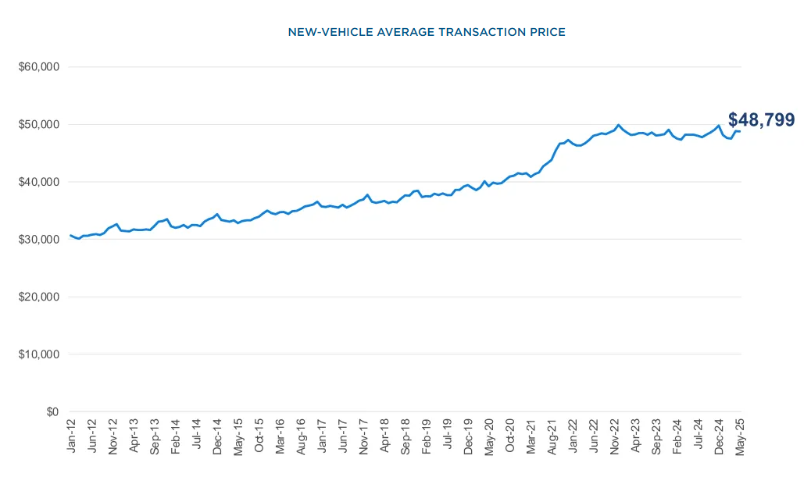
Cox Auto: May 2025 average new car transaction price $48,799
Graph and May average from:
(June 10, 2025). “Kelley Blue Book Report: New-Vehicle Prices Hold Steady in May,
As Automakers and Dealers Work To Offset Tariff-Driven Cost Increases.” Cox Automotive.
https://www.coxautoinc.com/market-insights/may-2025-atp-report/

Slide 23
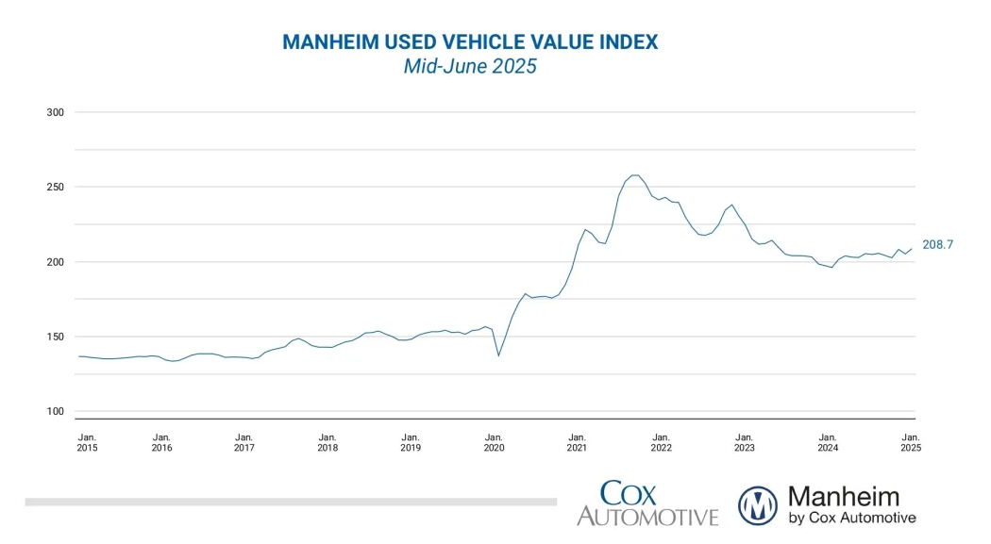
Mannheim Used Vehicle Value Index indicates used vehicle prices have increased slightly since summer 2024
Graph from:
(June 18, 2025). “Wholesale Used-Vehicle Prices Increase in First Half of June.” Cox Automotive.
https://www.coxautoinc.com/market-insights/mid-june-2025-muvvi/

Slide 24
Maintenance cost inputs insignificant to affordable choices
Value chosen: $74 per month
Why this was chosen: Maintenance cost per mile of BEV $0.061 at 14,489 miles a year (2022)
Source: Cost per mile from DOE, annual mileage from Federal Highway Administration
Maintenance

Slide 25
Insurance cost inputs insignificant
Best guess: $337 per month ($4,043 per year)
Why this was chosen: National EV average for 2024
Source: ValuePenguin
Insurance

Slide 26
Fuel costs not significant
Best guess: Varies by vehicle
Why this was chosen: Default values from FuelEconomy.gov
Source: FuelEconomy.gov
Fuel Costs

Slide 27
Sales tax assumptions insignificant
Value chosen: 7.25% tax rate
Why this was chosen: California base sales/use tax rate
Source: California Department of Tax and Fee Administration
Sales/Use Tax

Slide 28
High markups and optional extras have small impact
Value chosen: $684
Why this was chosen: Average new EV registration fees
Source: DMV.ca.gov
DMV and Document Fees, Dealership Markups and Extras

Slide 29
Interest rate assumptions modestly impactful
Values chosen:
11.18% for new
11.43% for used
Why this was chosen: Average interest rate during the second quarter of 2025 for credit scores 700–699
Source: U.S. News, 2025. Average Auto Loan Interest Rates
Interest Rates

Slide 30
Spreading loan over more time increases monthly affordability, debt
Value chosen: five years
Why this was chosen: previous year’s average loan term for used vehicles rounded to nearest year. Loan terms have been increasing, and are averaging 67.2 months for used cars in Q1 2025.
Sources: Lending Tree
Possible alternatives: 48 months (financial health recommendation), 74 months (new car average)
Finance Term

Slide 31
Increasing down payment increases monthly affordability, but may be inaccessible to many households
Value chosen: 10%
Why this was chosen: Typical Finance Assistance program down payment level
Sources: CARB Finance Assistance programs
Possible alternatives: 0% (lowest barrier to entry), 20% (financial health recommendation)
Downpayment

Slide 32
Transportation spending relative to income the highest impact input
Value chosen: 15%
Why this was chosen: closely aligns with the 2022 U.S. annual average transportation costs as a percent of after-tax income (Bureau of Transportation Statistics: Household Spending on Transportation)
Possible alternatives: 10% (financial health recommendation), 30% (average for lowest income quintile according to BTS)
?
Cost to income ratio

Slide 33
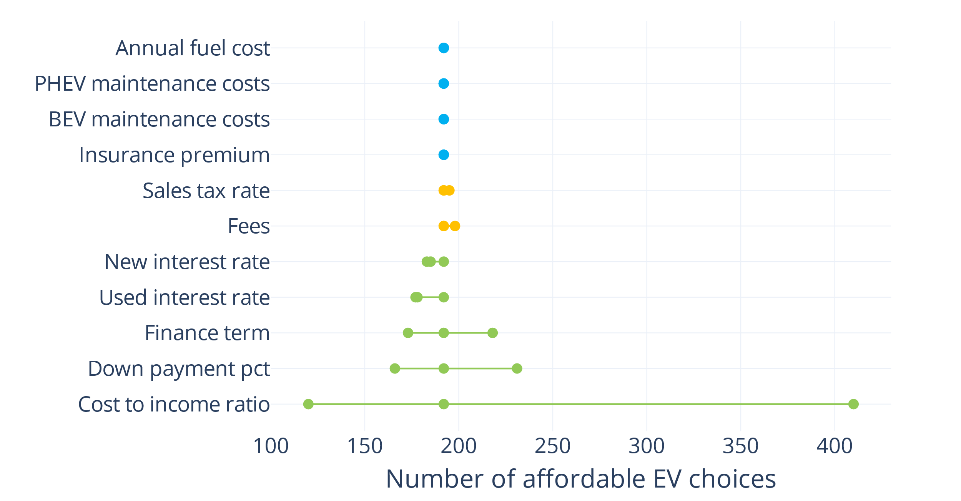
Previous Analysis: Most sensitive input is cost to income ratio
Vehicle Choices
Fewer
More

