Slide 1
Community-Based Organizations
Understanding EV Conversion facilitated by CBO Outreach
June 2022
Ben MacNeille, Data Scientist
Contributors: Lauri Walker, Francis Alvarez, and Meghna Eluganti
Notes:
Summarize what we are doing today: Turnipseed it!
-- Introduce myself, Jin Zhu, who works on the CVRP outreach team
-- tee-up all of the bigger points
Work with community-based organizations has been part of the CVRP outreach strategy for some time. CBOs are an important piece of the CVRP strategy to reach and engage with priority populations, low-income, and disadvantaged communities.
Much of the effect of CBOs is not easily tractable via the data at hand, and what is represented here is a small sliver their daily activities. The social capital these groups have make them truly unique resources for the CVRP.

Slide 2
Community-Based Organizations (CBOs)
Trusted Community members
Knowledge of community priorities and challenges
Provide a wide-variety of important services
Financial literacy
Education
Weatherization services
Job training
Health advocacy
CBOs are the foundation of the CVRP Community Partner Network
Statewide coverage, located in Disadvantaged Communities
Notes:
USE: community partner,
CBOs have an understanding about the specific needs of their communities.
Weatherization services: LMI community that qualify for energy efficiency retrofits (ESA funding)

Slide 3
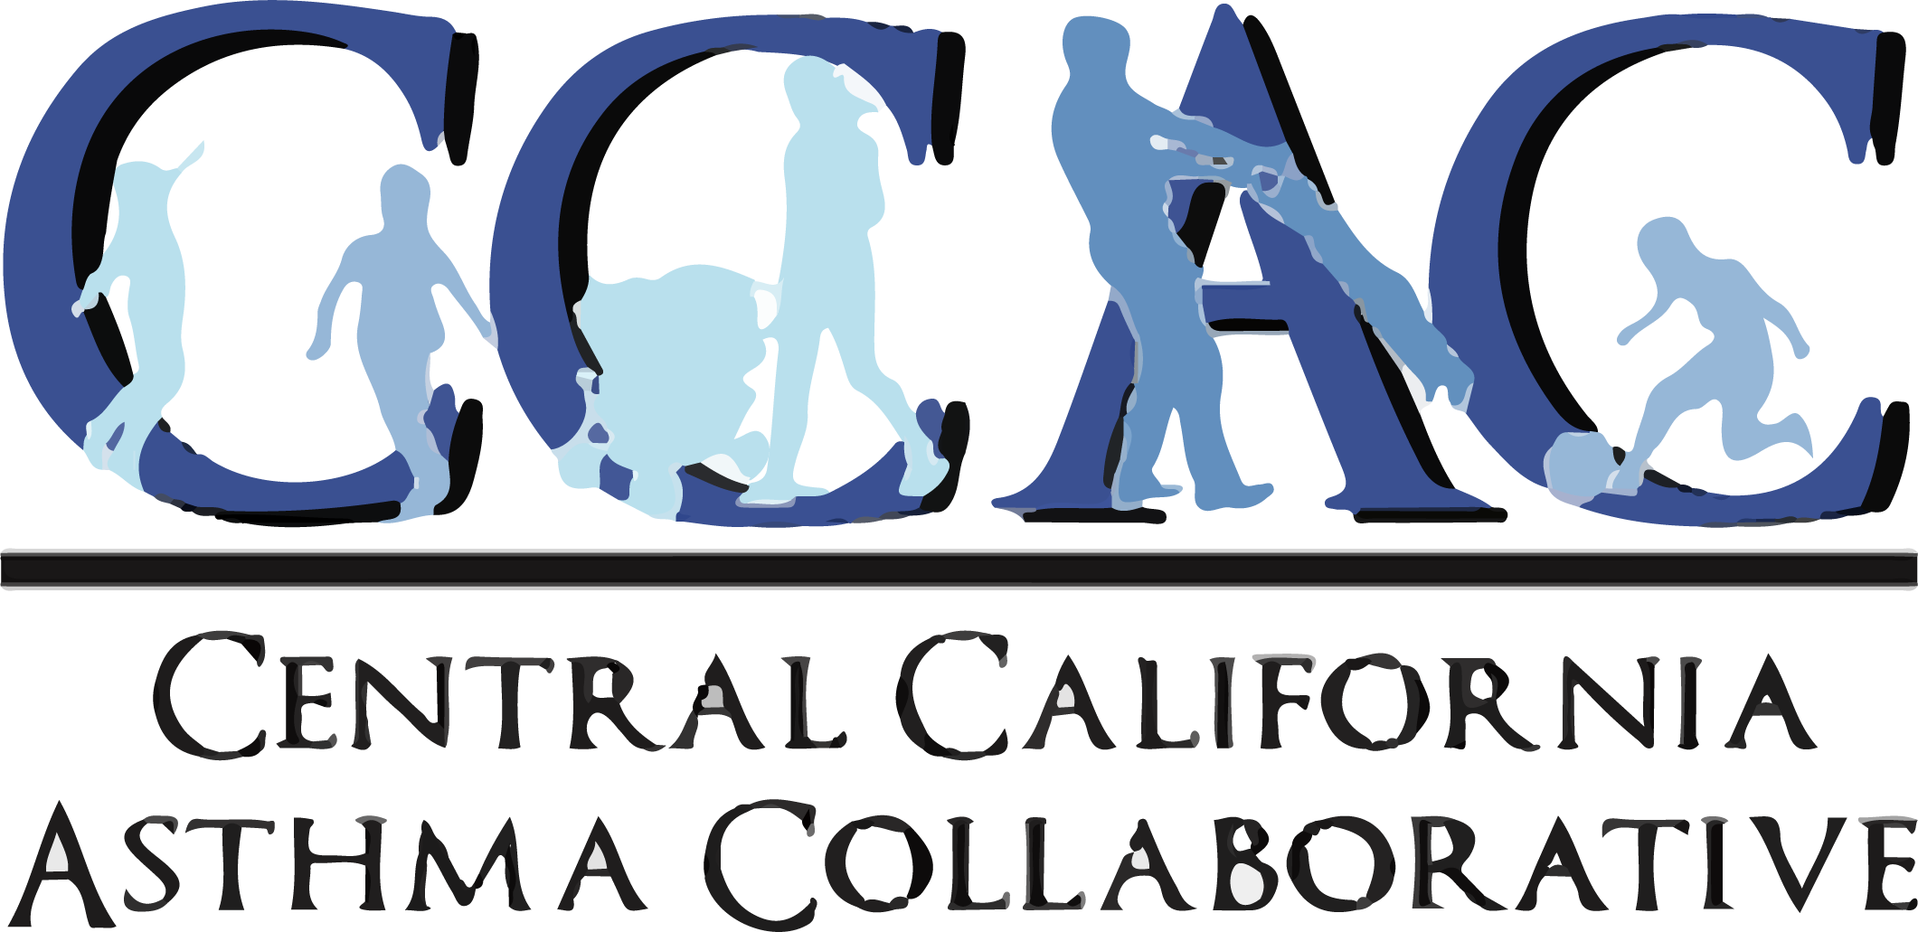
CVRP Community Partner Network: CBOs
Central California Asthma Collaborative (7 CBOs throughout Central California)
Metropolitan Area Advisory Committee (San Diego and Imperial County)
Liberty Hill Foundation (Los Angeles)
Community Resource Project (Sacramento, Yolo County)
Reach Out (Upland, Jurupa Valley, and Yucca Valley)
Groundwork San Diego (San Diego County)
Comite Civico del Valle (Imperial County)
Notes:
We are going to be talking about these community partners, they are in several regions, and together they loosely have statewide coverage.
Central California Asthma Collaborative: - Clean Vehicle Empowerment Collaborative – 7 total CBOs throughout central California. The collaborative was built via funding from CVRP and others. They get information out to DACs about EVs and the benefits of cleaner air (Jin knows about this)
CCAC - Providing education and direct services, build regional capacity and advocate for sensible policies that improve health and address inequities by reducing environmental impacts and emphasizing the prevention and management of chronic disease.
MAAC - Maximizing self-sufficiency with families and individuals through high-quality programs and advocacy in our communities.
Liberty Hill – Former partner. We invest in changemakers and equip them with the skills and relationships they need to build power and advance social justice.
Community Resource Project - Improving opportunities for people in need through energy efficiency, health, and education.
Reach Out – Former partner. Strengthening communities by bringing people together to solve our region’s toughest issues: breaking barriers to educational achievement, expanding economic opportunities, and creating safe, healthy and innovative communities.
Groundwork - Improving the environment, economy and quality of life for residents in the Chollas Creek Watershed through new approaches to community and educational development.
Comite Civico del Valle - Informed people build healthy communities.
MAAC Project: Liberty Hill Foundation: https://www.libertyhill.org/ - they are no longer a partner in 2022
Community Resource Project: https://www.communityresourceproject.org/About-Us/Mission-Vision-Values
Reach Out: Groundwork San Diego: /about/#history-mission
Civico del Valle: /about.php

Slide 4
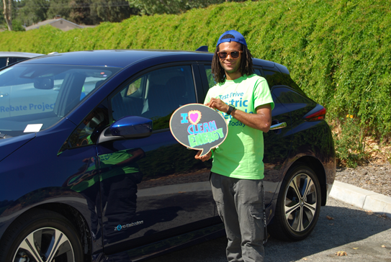
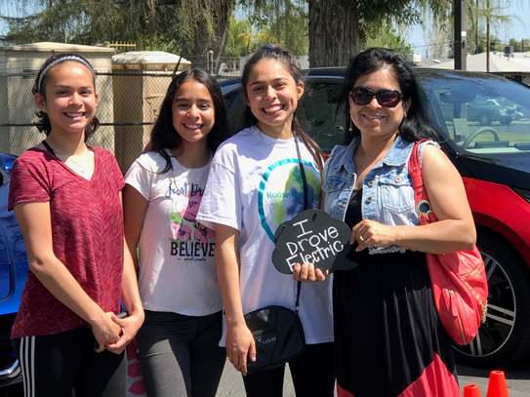
CBO Activities
Community workshops
Test drives
Canvassing
Art contests
Digital marketing
One-on-one educational assistance on CVRP and other stackable incentives
Notes:
During our on going training with the CBOs one area is to run through a community presentation. Community workshops or Presentations allows more time with the resident to review the benefits of EVs and showcase the CVRP increased incentive and other stackable incentives utilizing the Savings Calculator tool which is a visual and effective tool.
We have found that Test Drives or "butts in the seat" is the fastest way to explain an EV. Behind the wheel is one of the most effective ways to make a lasting impression and convert a conventional gas powered driver to an EV Driver
We have also had selective CBOs that specialized in canvassing their communities to share important information with them and their families where they live. COVID temporarily stalled this approach of outreach, but we are starting to learn that more CBOs are continuing this.
A few of our CBOs have been engaged with the youth to get information onto the parents through art contests where the parents become involved in the project and learn quite a bit on EVs during the contest process. This is also a unique way to bring in more community member and engage with our youth on EVs.
Web banners, newsletter content and social media posts, most of our CBOs utilize our digital marketing kits developed by the CSE Marketing team for the CBOs to reach their audience with engaging content that can be share digitally with others.
Several of our CBOs have additional staff that have an opportunity to work with residents through the CVRP process and other program processes in order to take advantage of multiply stacking EV programs which brings down the cost of the EV and makes the purchase much more realistic

Slide 5
CBO Activities Statewide
373 recorded CBO activities between April 2019 – March 2022
7 direct CBO partners and 7 additional umbrella partners under Central California Asthma Collaborative
CBO strategic outreach activities:
In-person events: Community events, workshops, presentations and consultations
Distributed activities: Flyer distributions, newsletters, phone banking and social media posts
Notes:
Asynchronous activities, don’t value judge the types of outreach

Slide 6
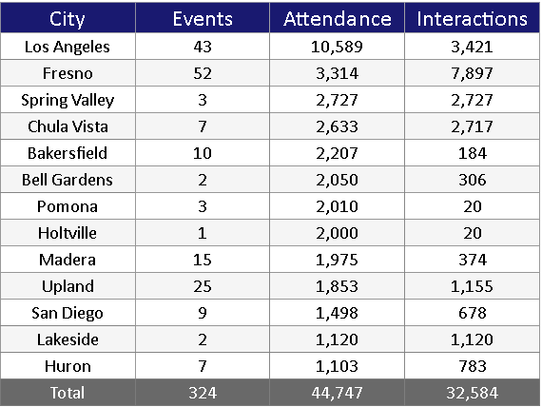
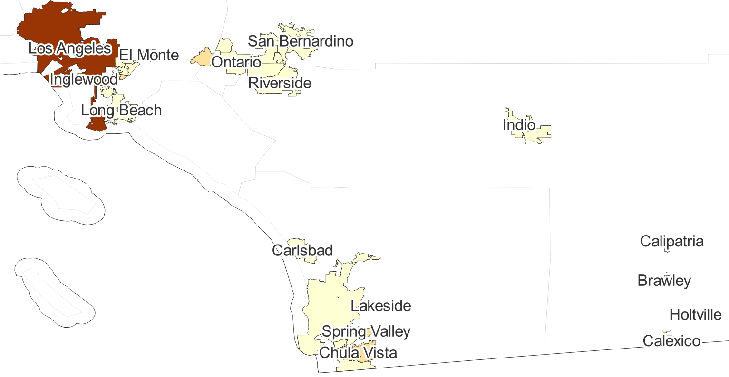
CBO In Person & Live Events
Southern California
Attendance
0 – 2,000
2,000 – 4,000
4,000 – 6,000
6,000 – 8,000
8,000 – 10,000
10,000 – 10,589
*Includes networking/workshops, community events, consultations, presentations, EV focused events and virtual presentations
Notes:
Pronounce places well – speak more to the region rather than particular cities

Slide 7
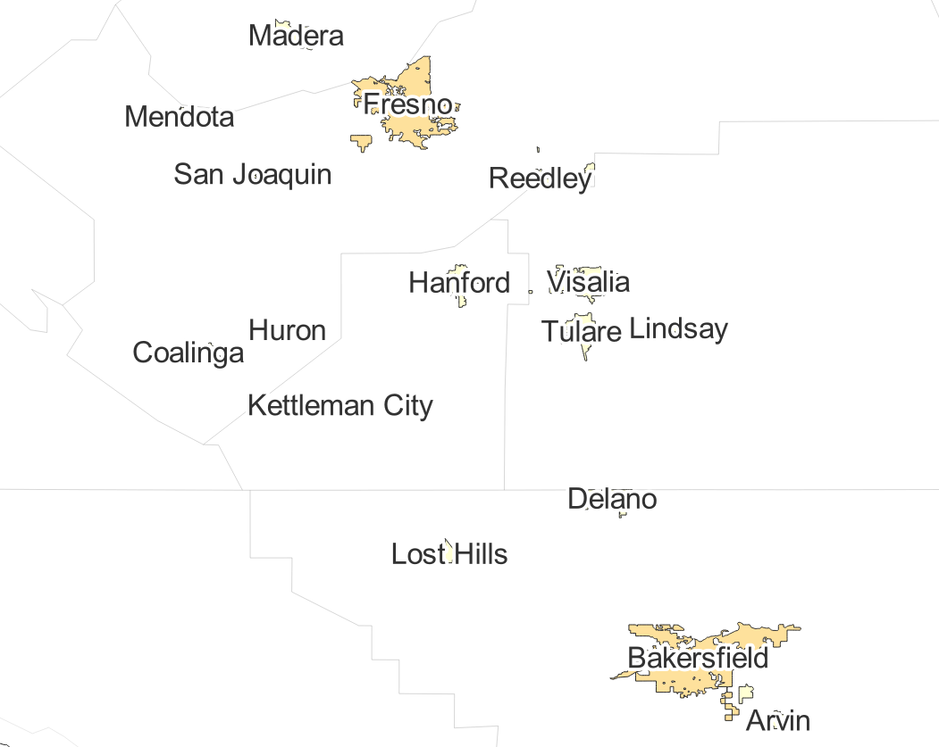
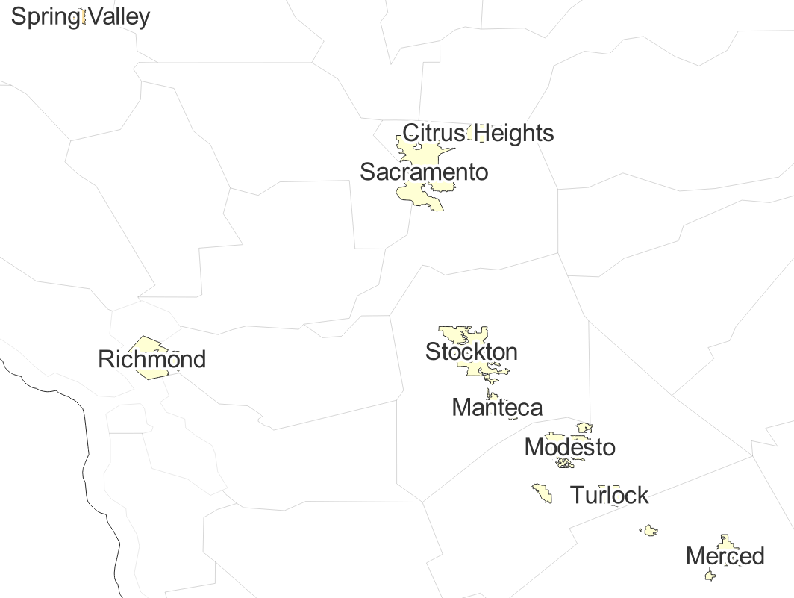
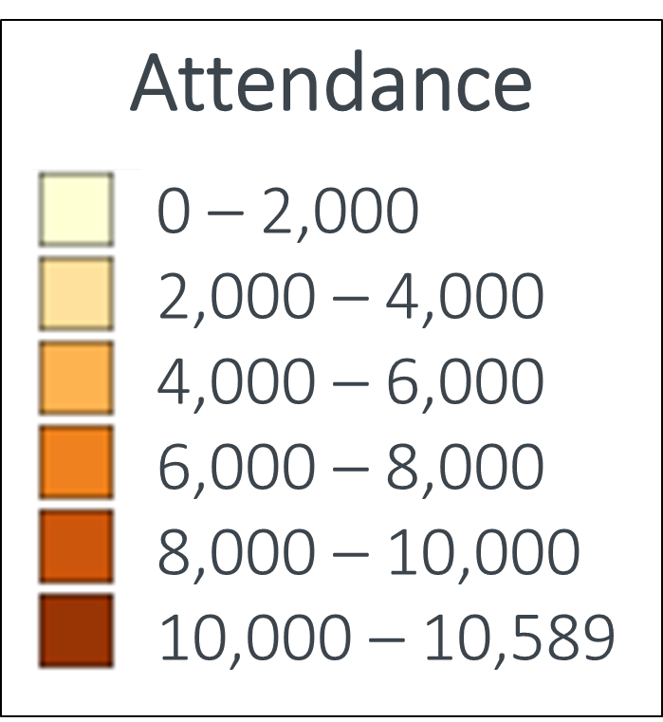
CBO In Person & Live Events
Central California
Northern California
Notes:
We do a lot of outreach to DAC and LICs in the Central Valley

Slide 8
CBO Influence on CVRP Participation
CBO influence on CVRP participation was analyzed via the survey question:
“Please rank the top three most influential information sources
when you were deciding whether to acquire a plug-in electric vehicle (PEV).”
Non-profit Organization* Another PEV driver Vehicle test drive Dealer/salesperson |  | Third-party vehicle review or car-buying website (e.g. Edmunds, Consumer Reports, KBB) Electric utility My employer | Manufacturer website News story Social media Online discussion forum
Influenced by Non-profit Organization
Not Influenced by Non-profit Organization
Notes:
These aren’t just CBOs, so not perfect apples to apples

Slide 9
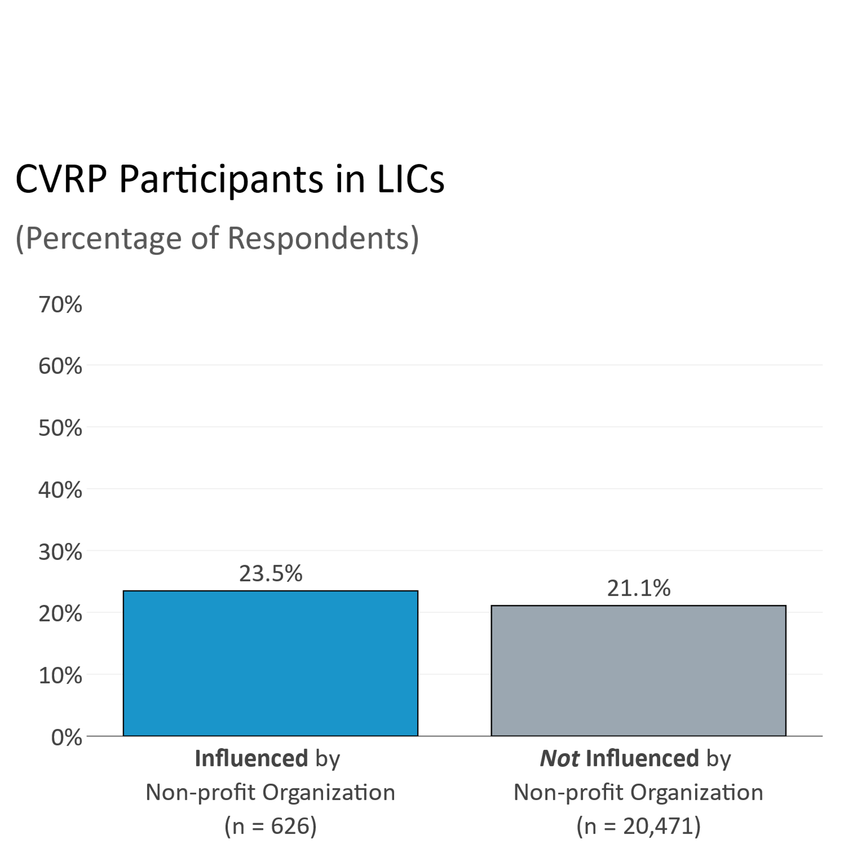
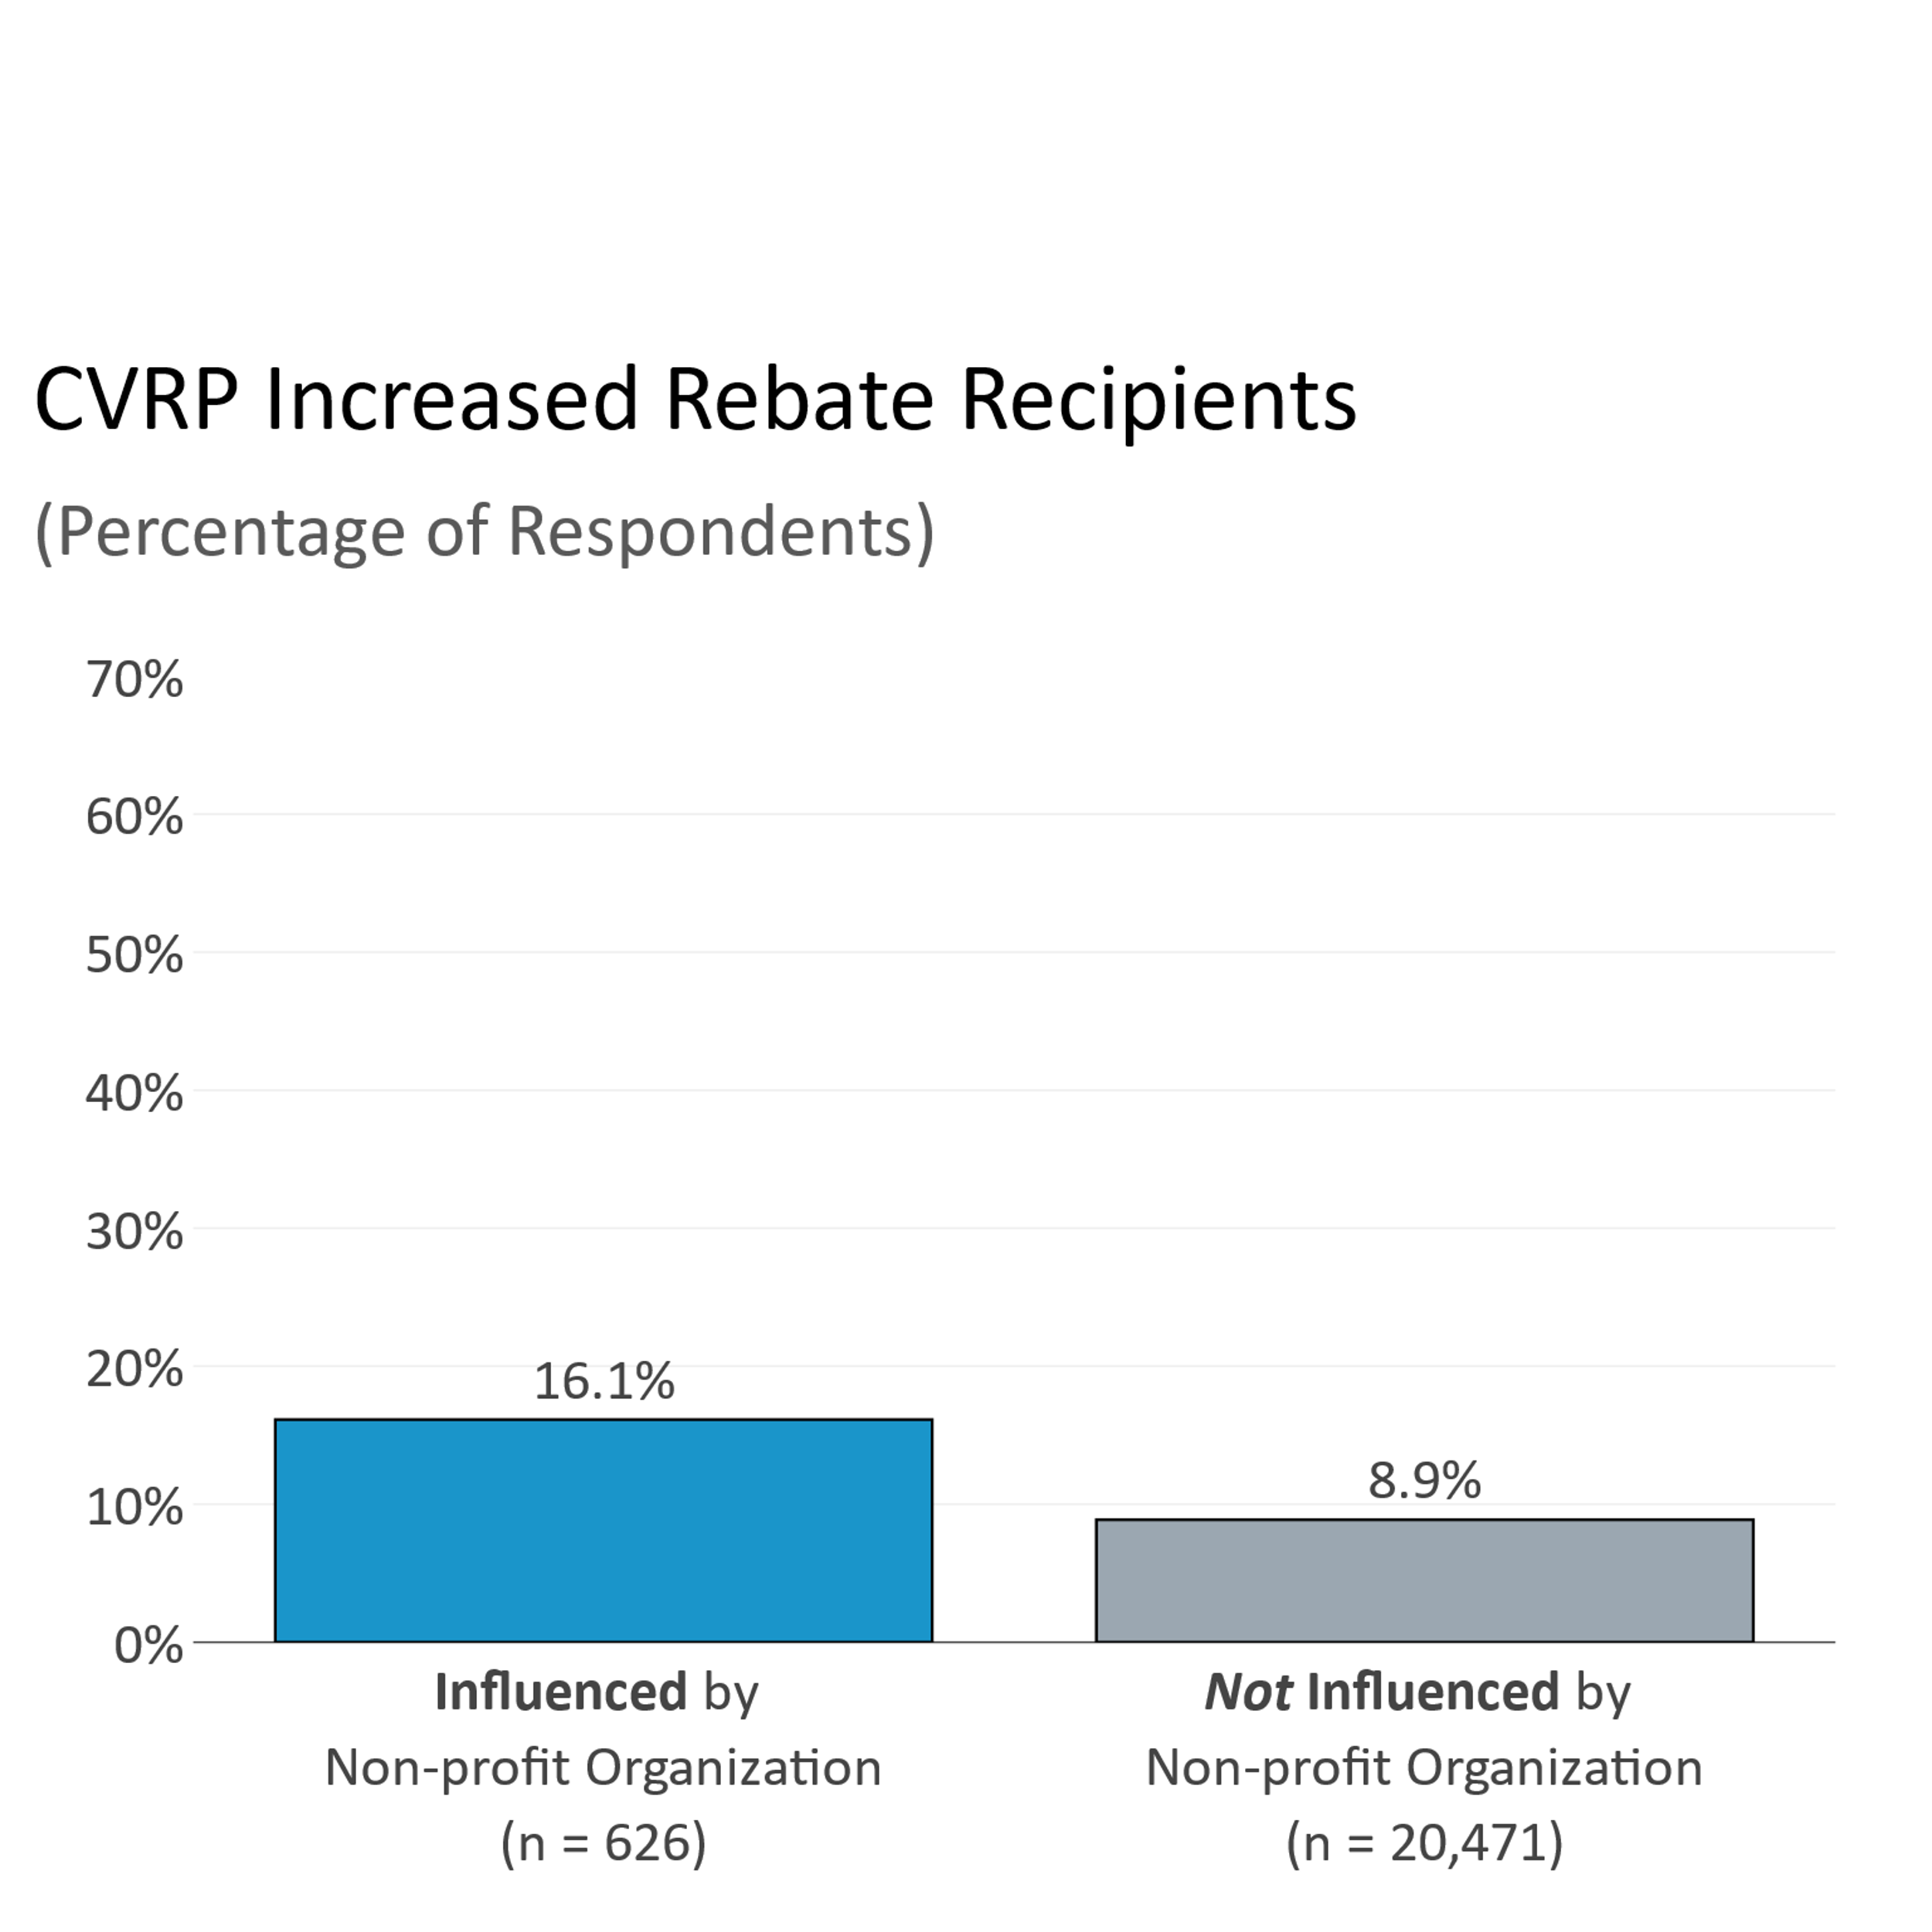
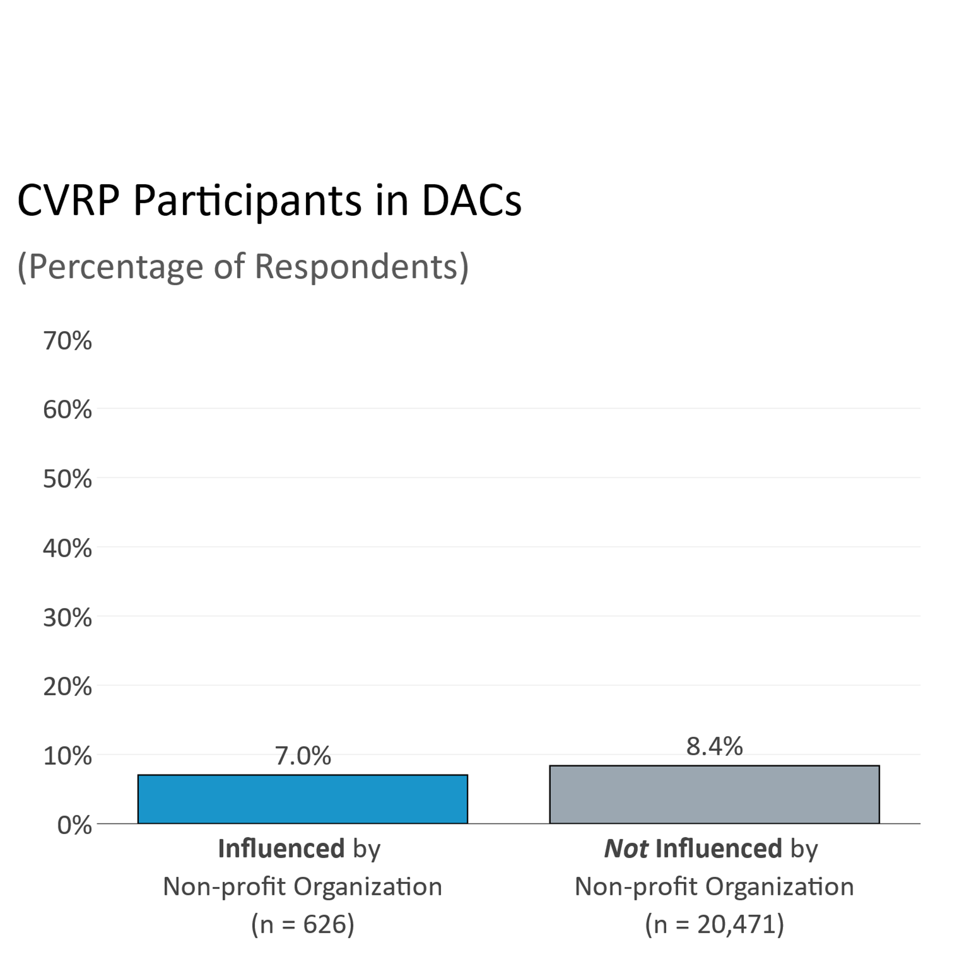
Populations Influenced by Non-profit Organizations
*statistically significant difference (alpha < 0.01)

Slide 10
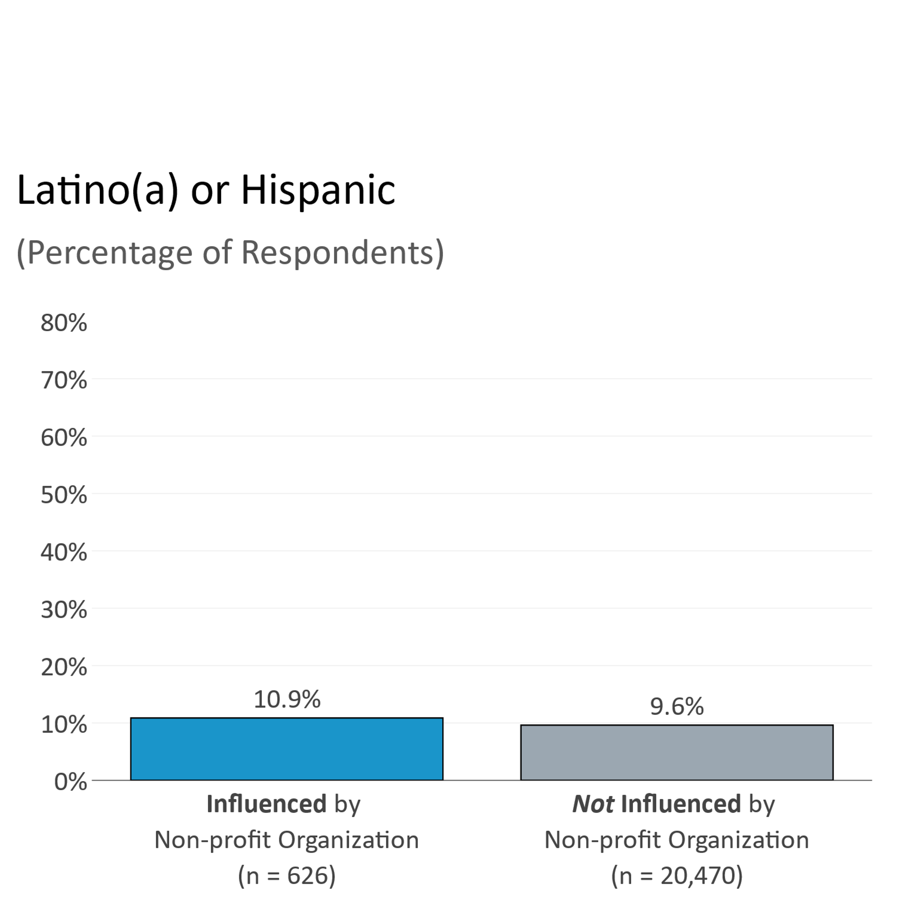
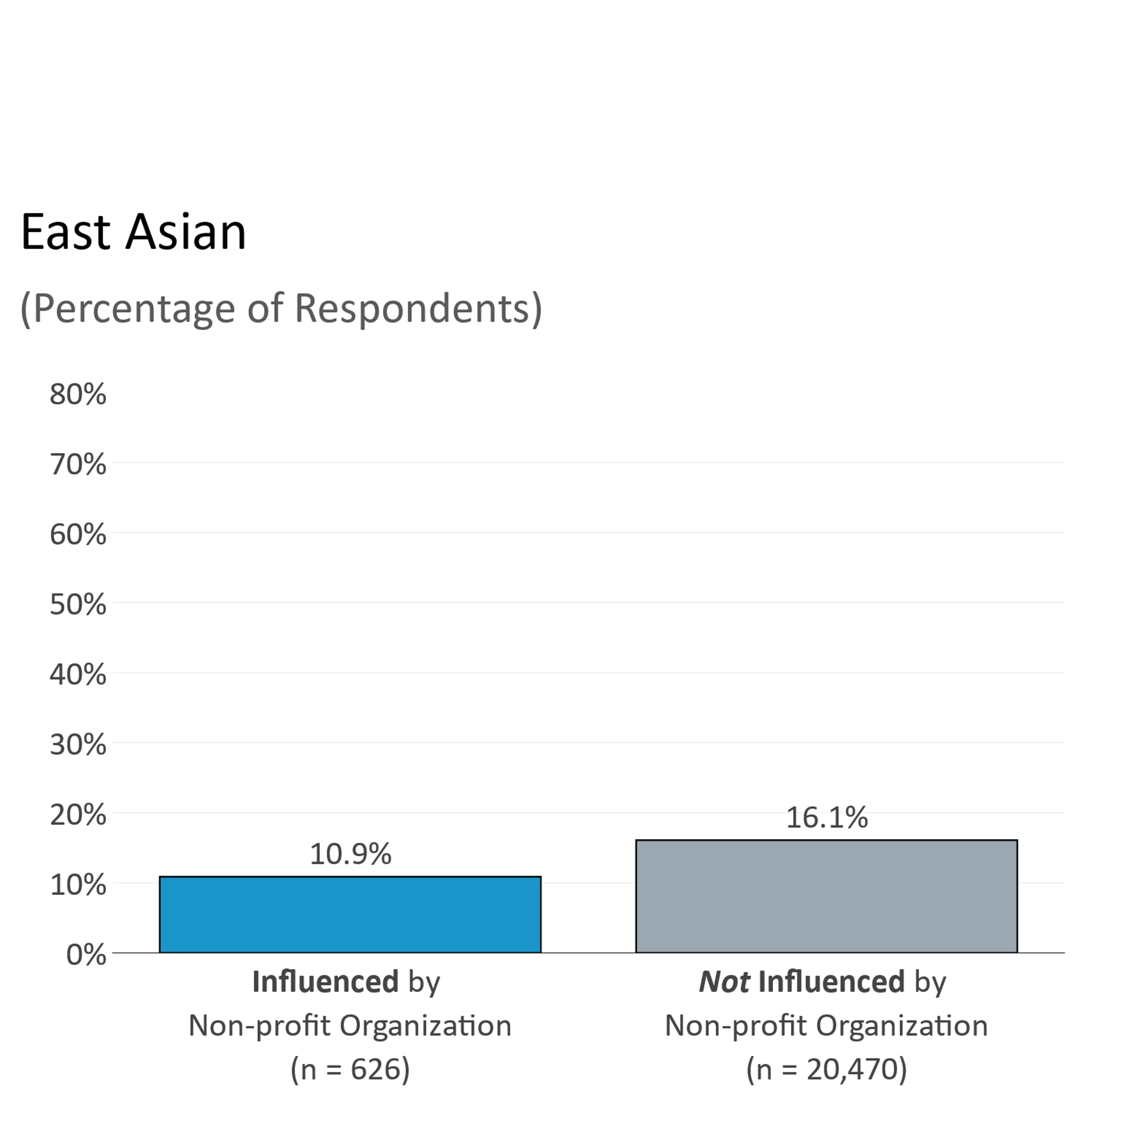
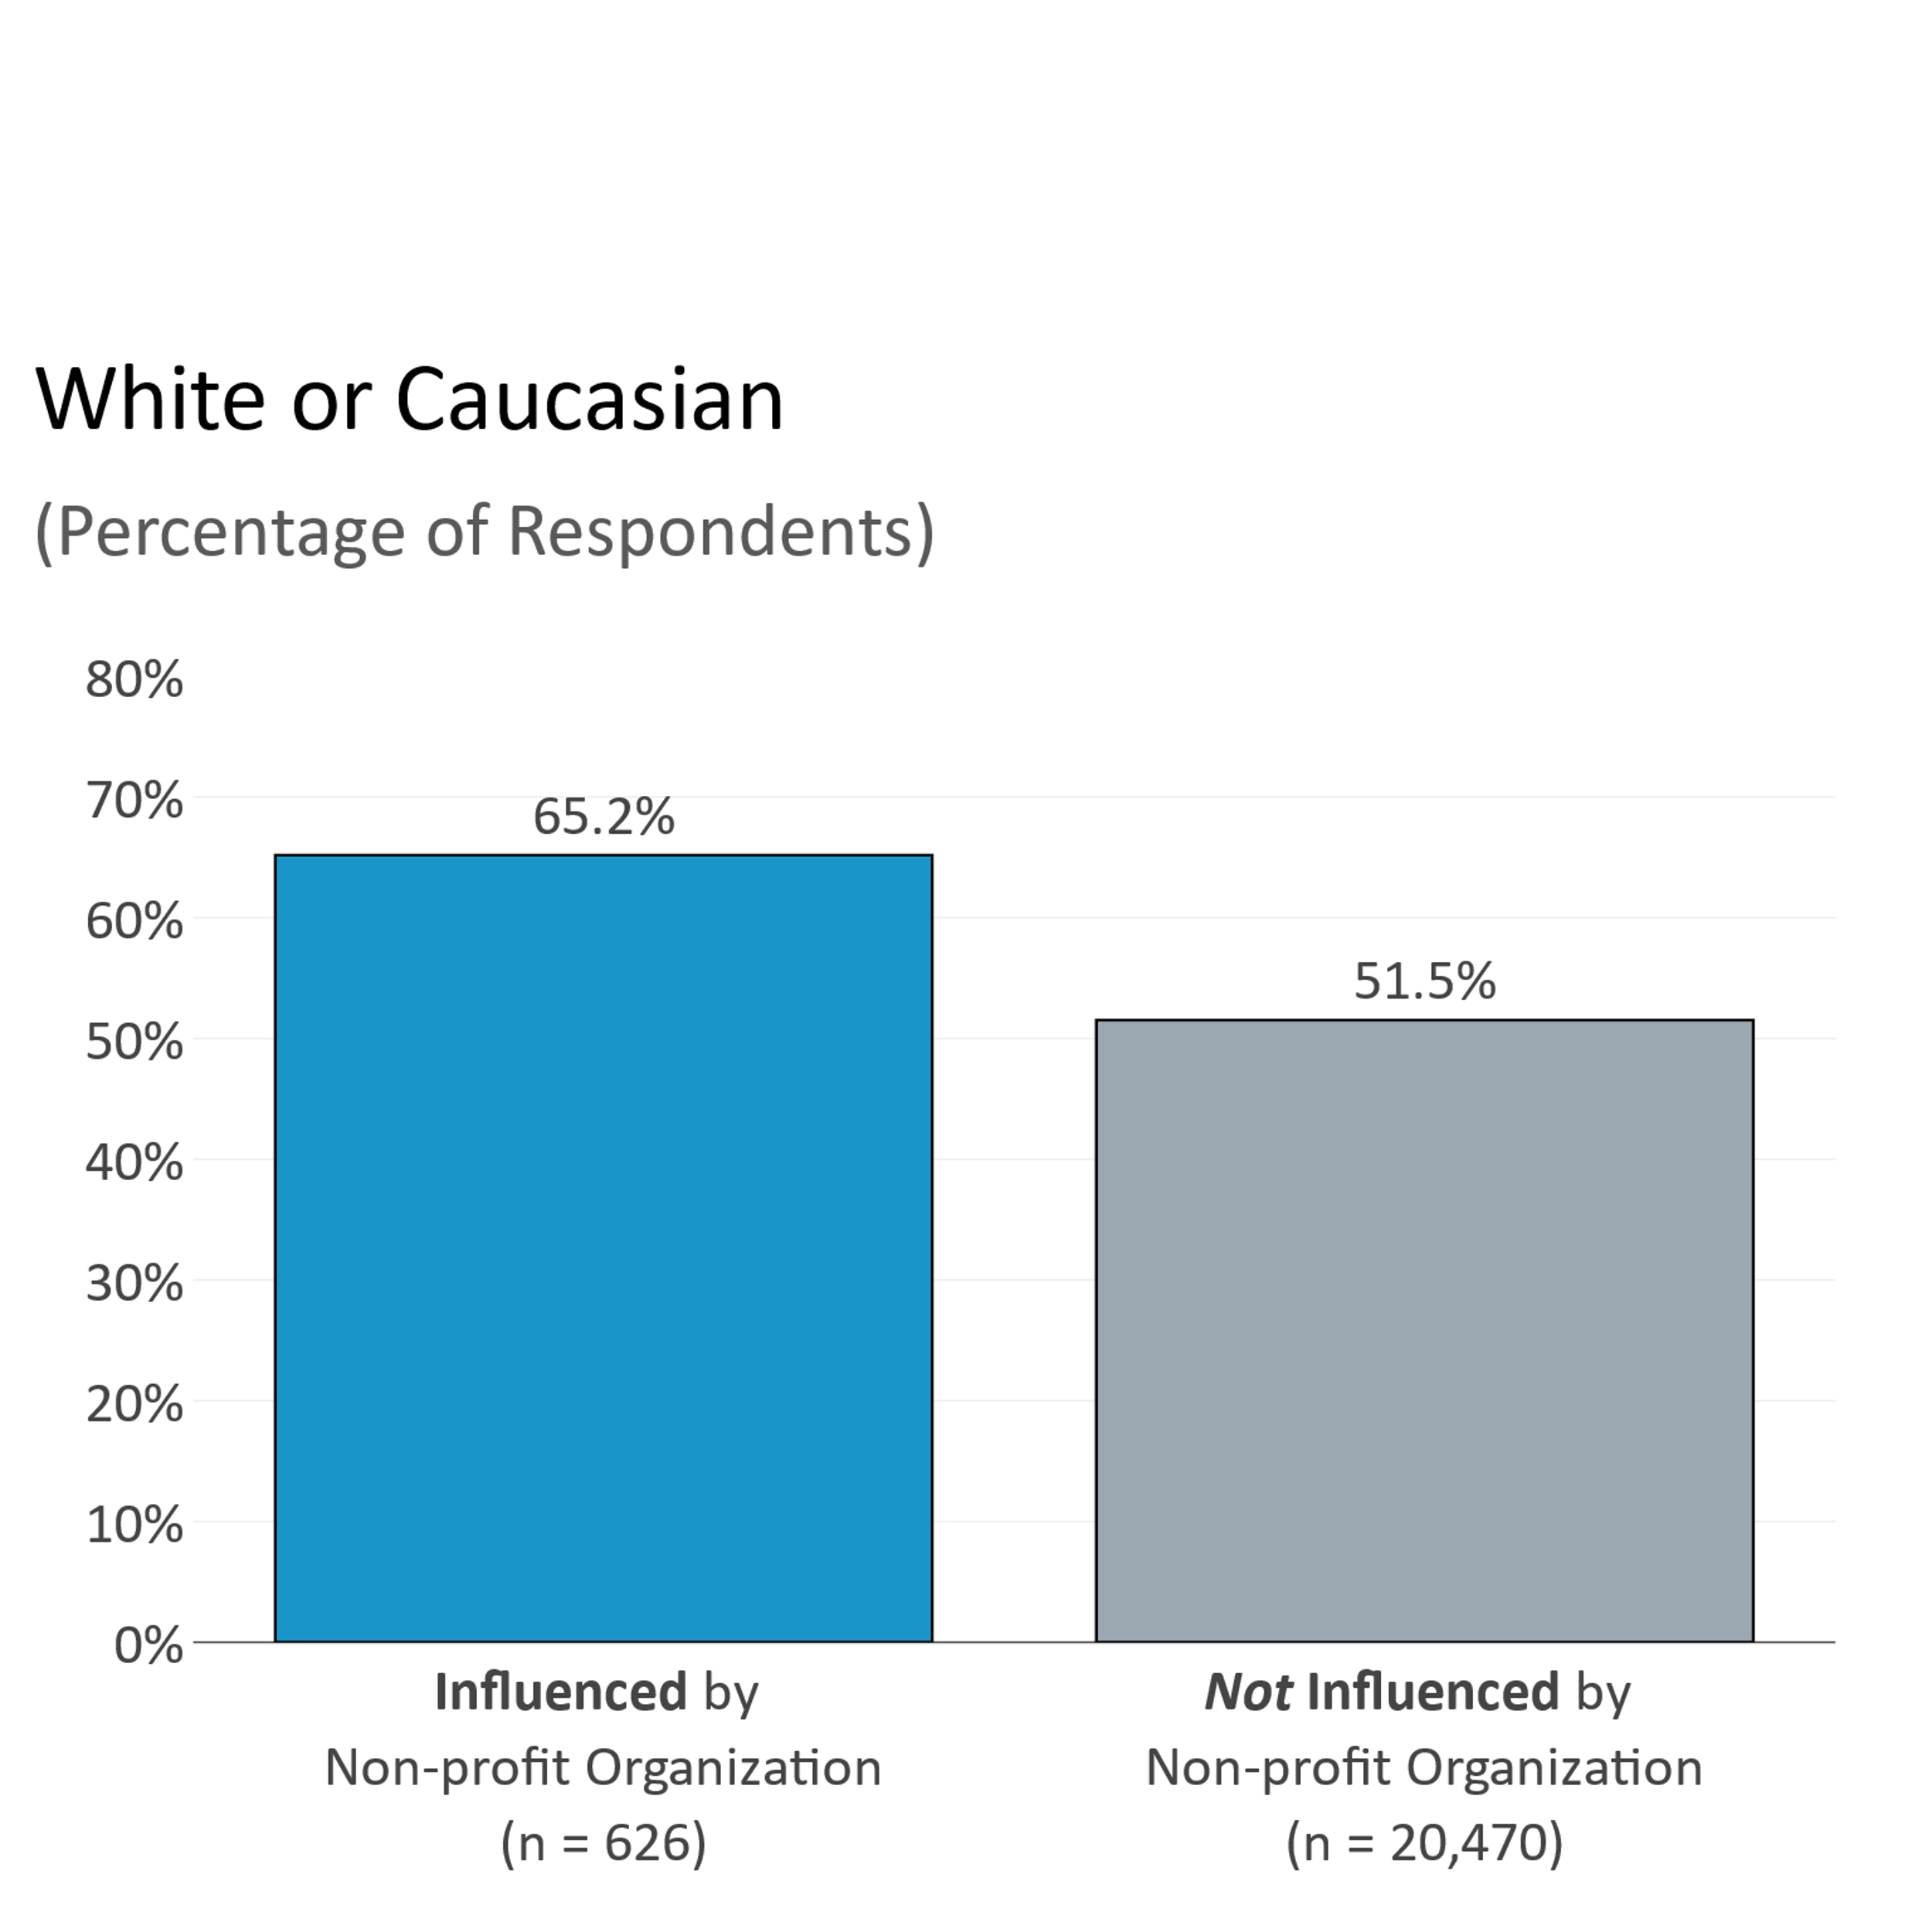
Populations Influenced by Non-profit Organizations
*statistically significant difference (alpha < 0.01)
*statistically significant difference (alpha < 0.01)
Notes:
The CBOs are working with minorities moreso

Slide 11
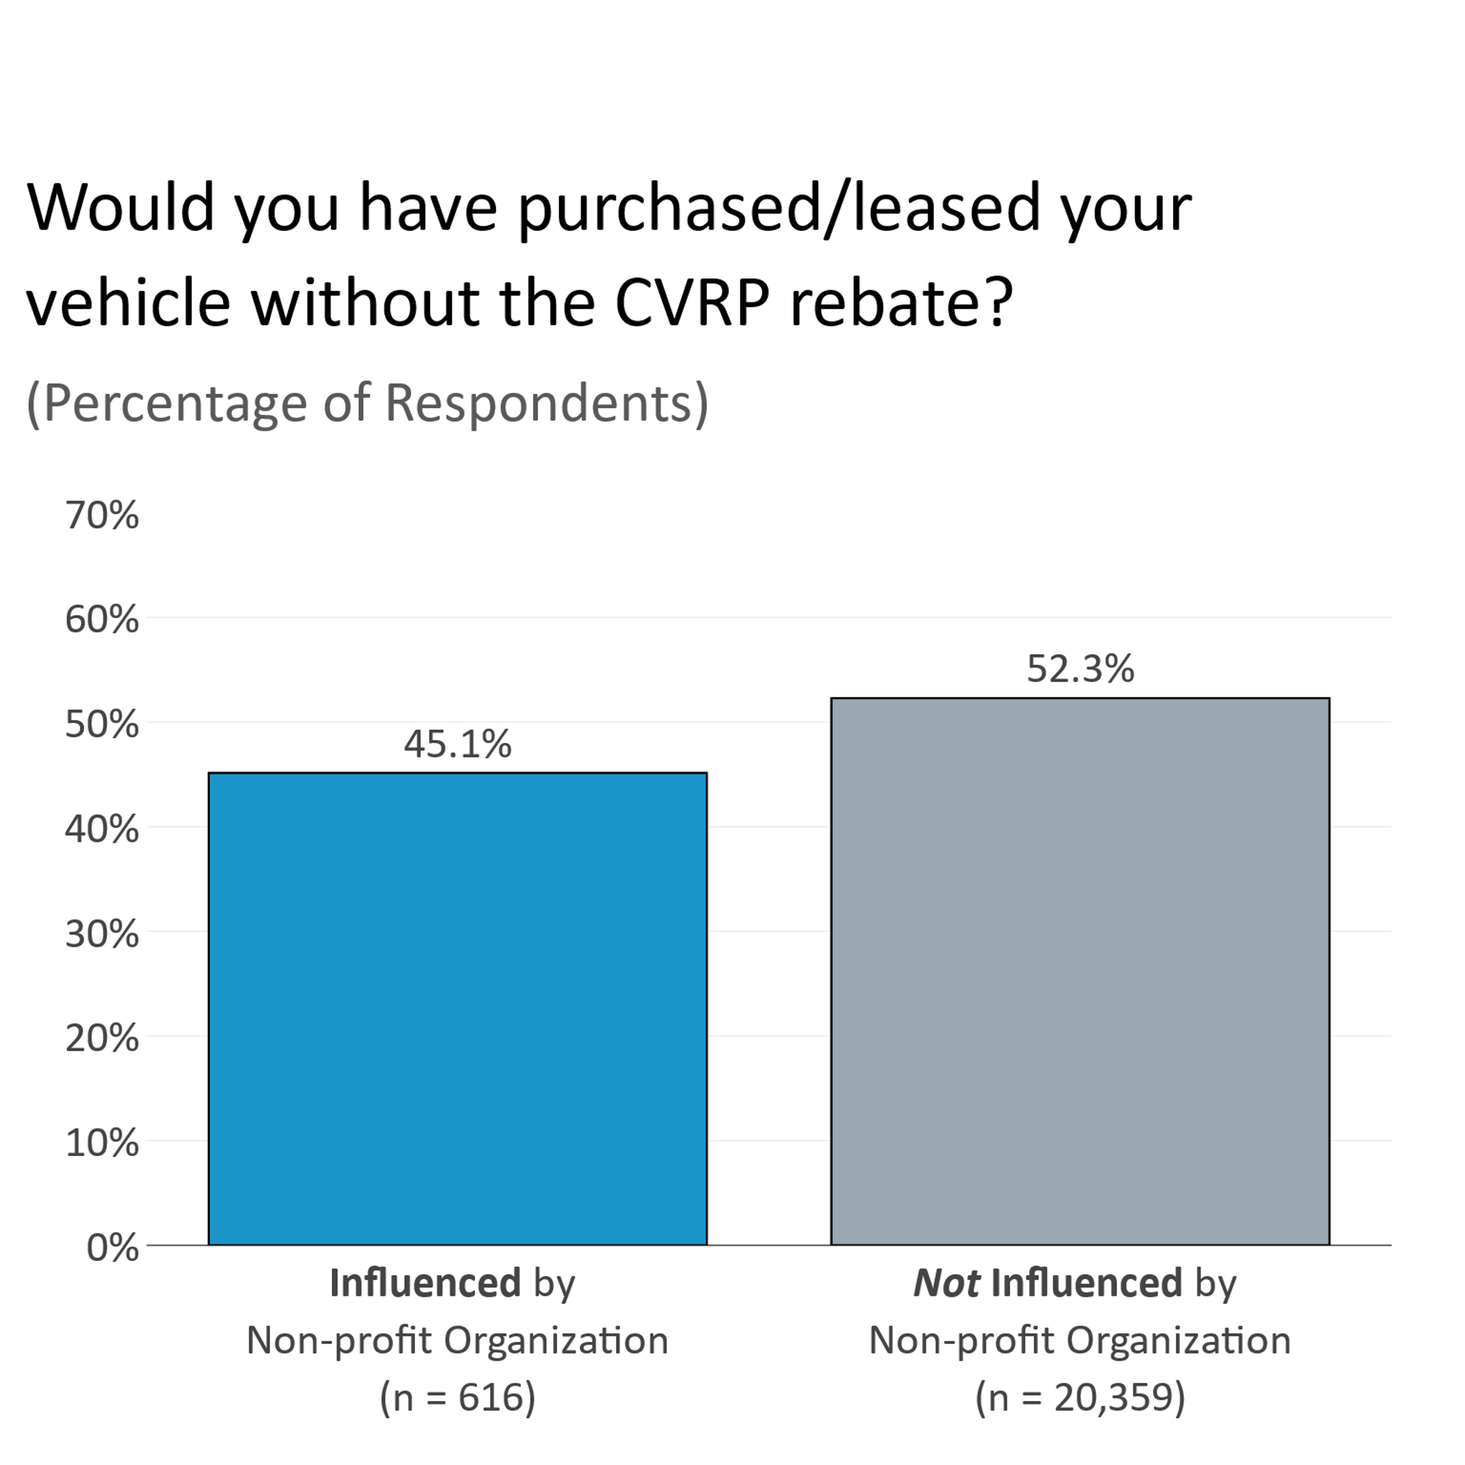
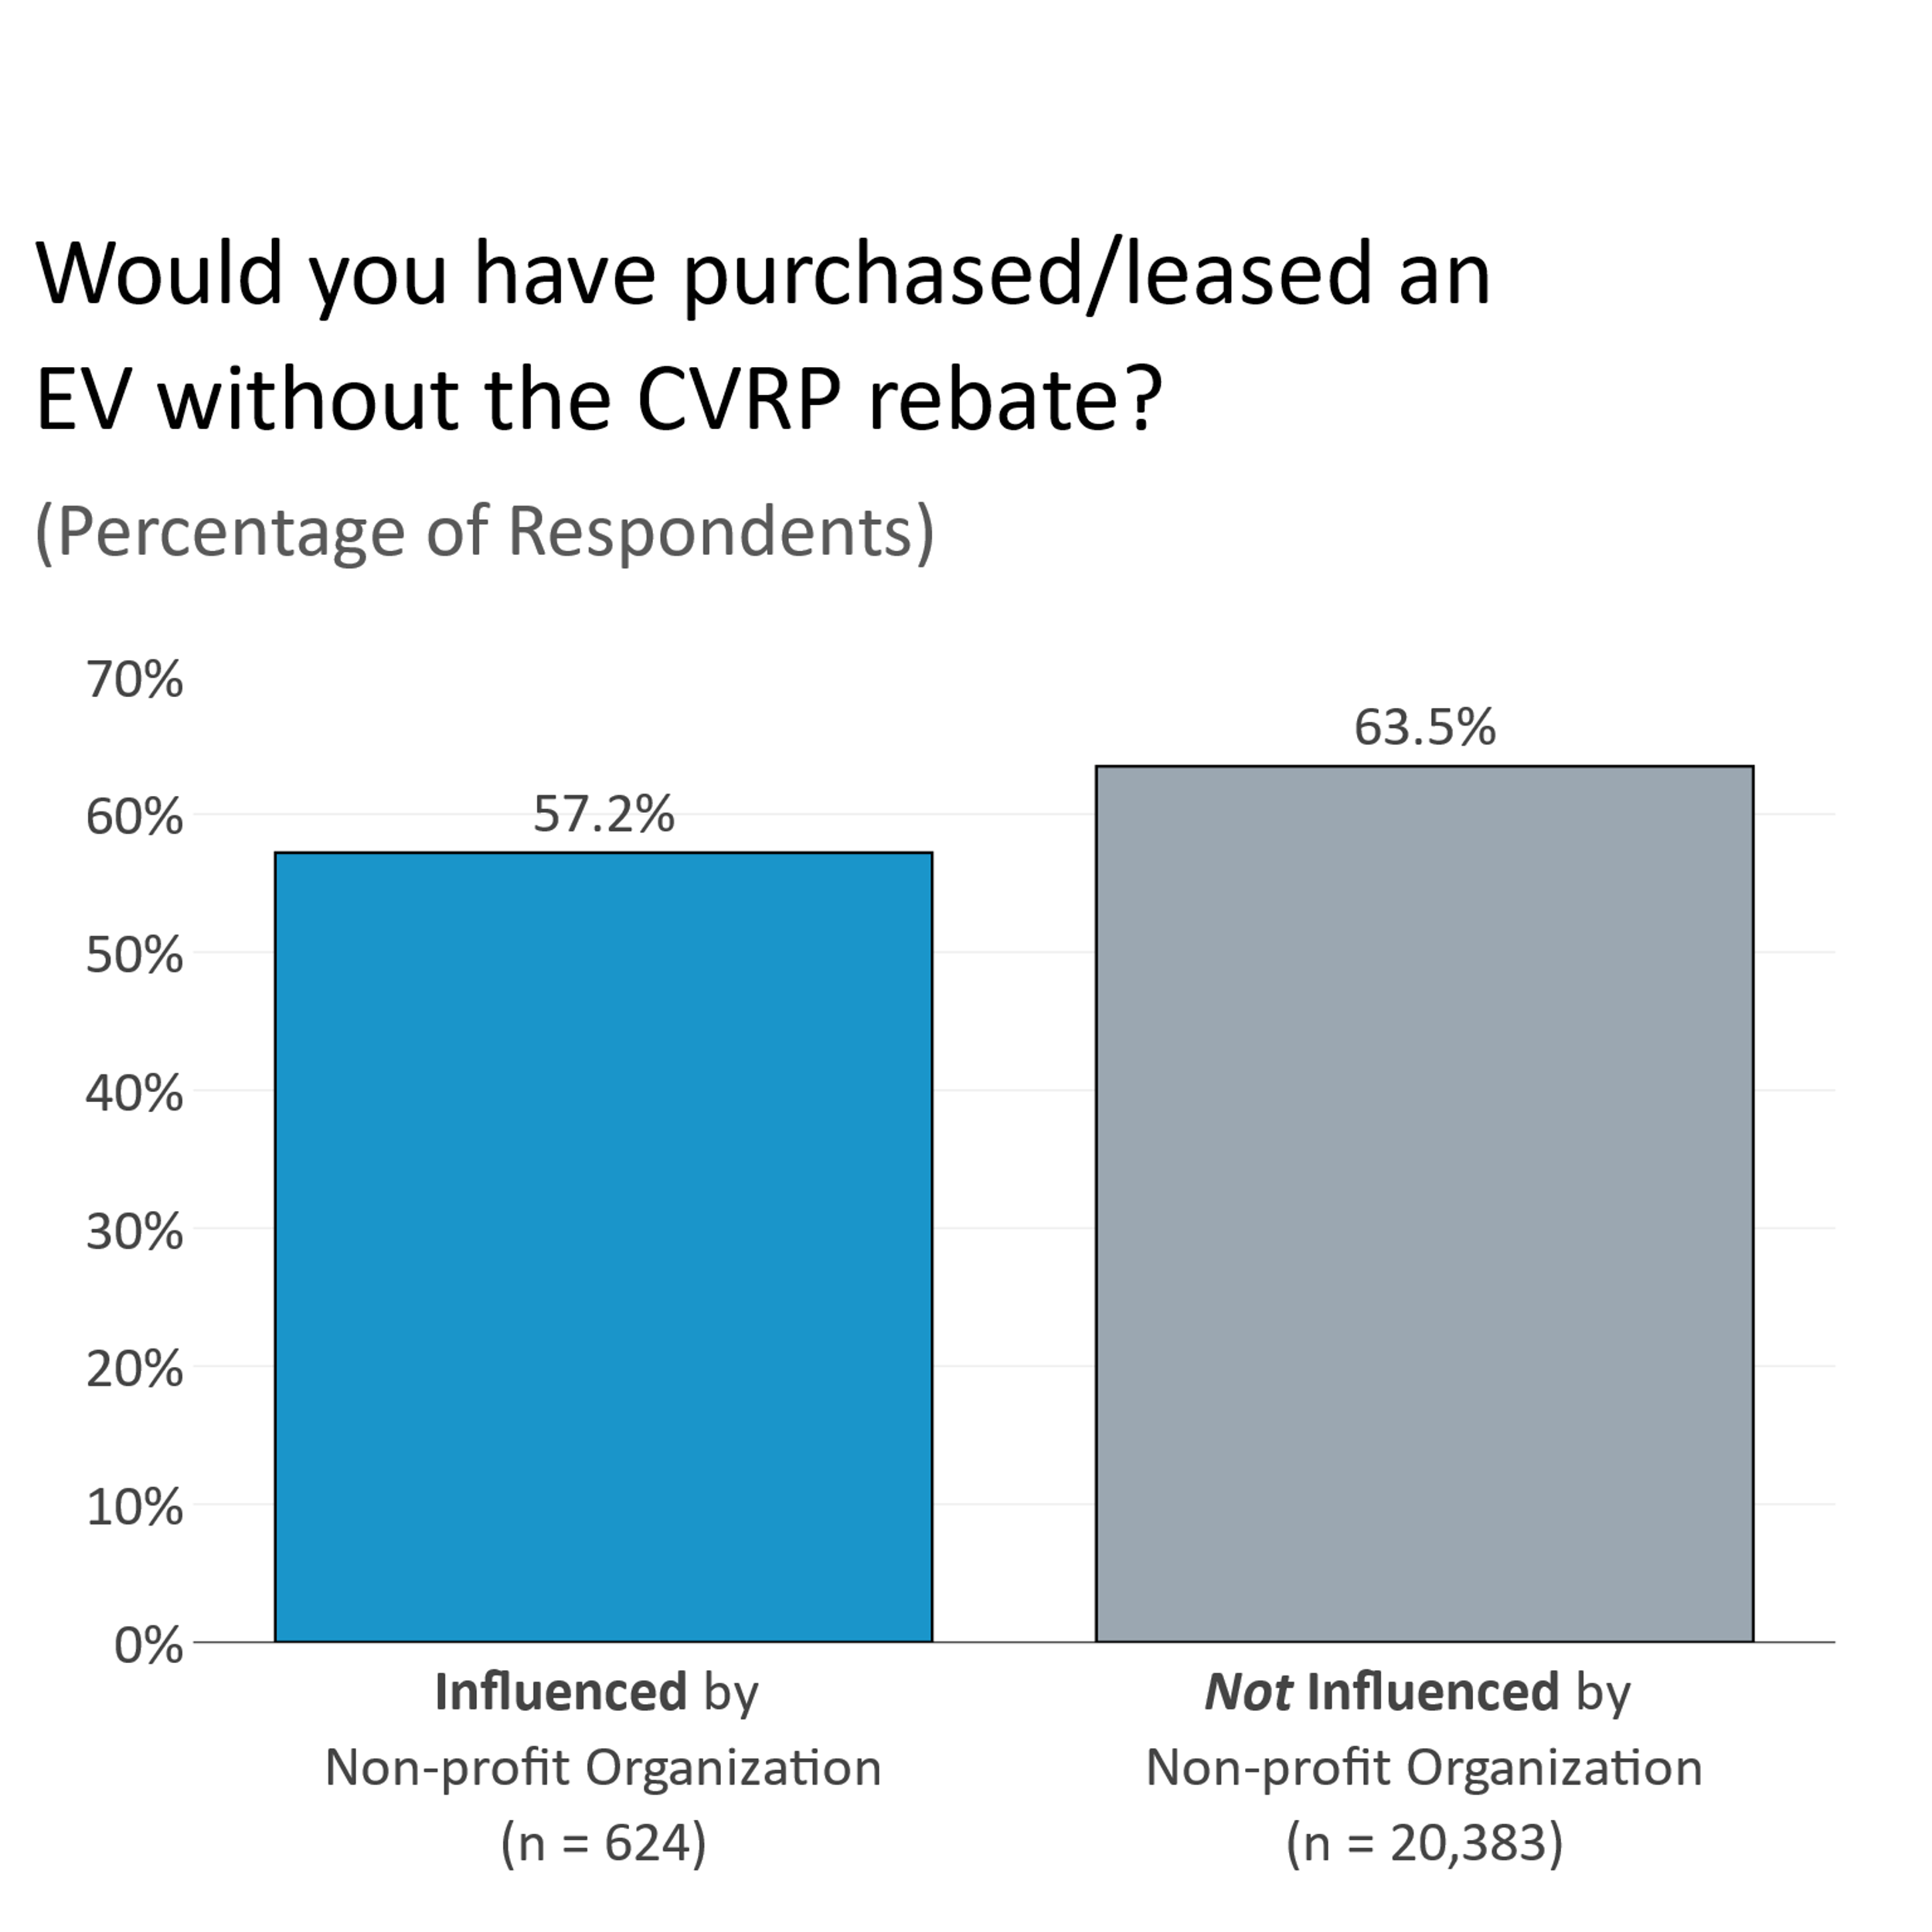
EV Conversion Influenced by Non-profit Organizations
*statistically significant difference (alpha < 0.01)
*statistically significant difference (alpha < 0.01)

Slide 12
Future Studies
Collect data to evaluate engagement efforts quantitatively
Exit surveys for participants after events/workshops/presentation
What were the barriers for participant attendance?
What did you know about CVRP before the event vs after?
Why did you attend?
Additional CVRP Consumer Survey questions
Interviews with CBOs
Understand CBO informational needs
Ask what we could improve – communication, support, informational materials, etc.
Review methods for community engagement
Explore means to measure efficacy of engagement
Notes:
Interviews are happening in Q3, not related to
Events are more like festivals, and other family-oriented events. Workshops and Presentations are more of an issue for child care issues. Workshop/presentations are very different from events.

Slide 13
Upcoming Community Partner Network Efforts
CVRP CBOs will continue to increase focus in priority communities:
Working with tribal communities to coordinate outreach and test drives
Outreach to the African-American community
Partnership with Pryor Consulting (Black-woman-owned business)
Upcoming Community Partners (July 2022)
Community Housing Development Corporation (Richmond/Bay Area)
California Interfaith Power and Light (statewide with a focus on Los Angeles, Riverside and San Bernardino Counties)

